Slide 1
What are the best attributes in a wine to pair with Spicy Food?

Slide 2
Pairing rules, says it should be:
Low Alcohol
Good Acidity
Off Dry
Fruity Aromatics
No Oak
No Tannins
White Wine
Effervescence
Low temperature

Slide 3
We have a great opportunity with a wine that has all of these attributes combined!
But also has :
Great Packaging!
Great Price!
Great for Cocktails !

Slide 4
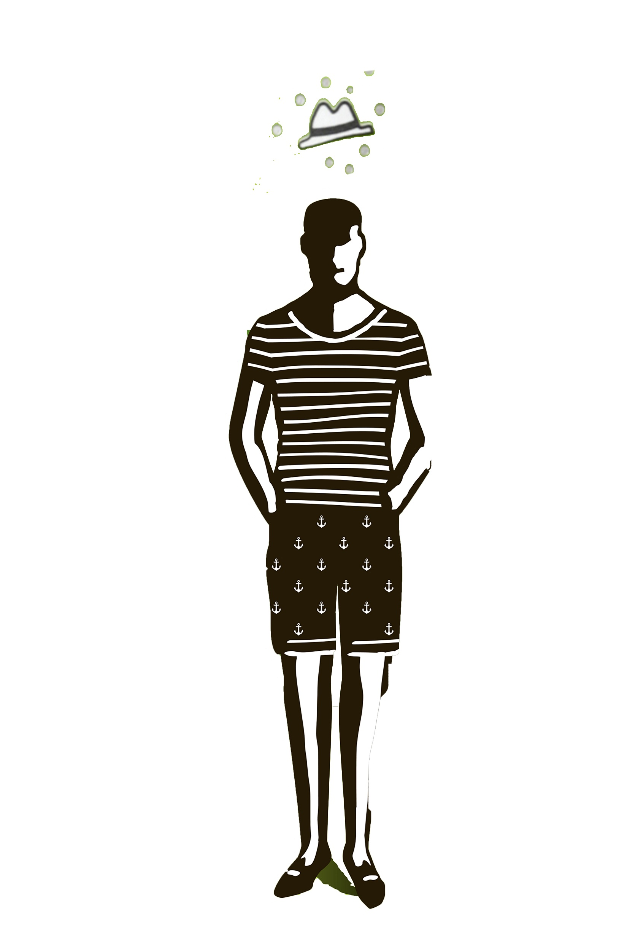
I think you are talking about ………

Slide 5
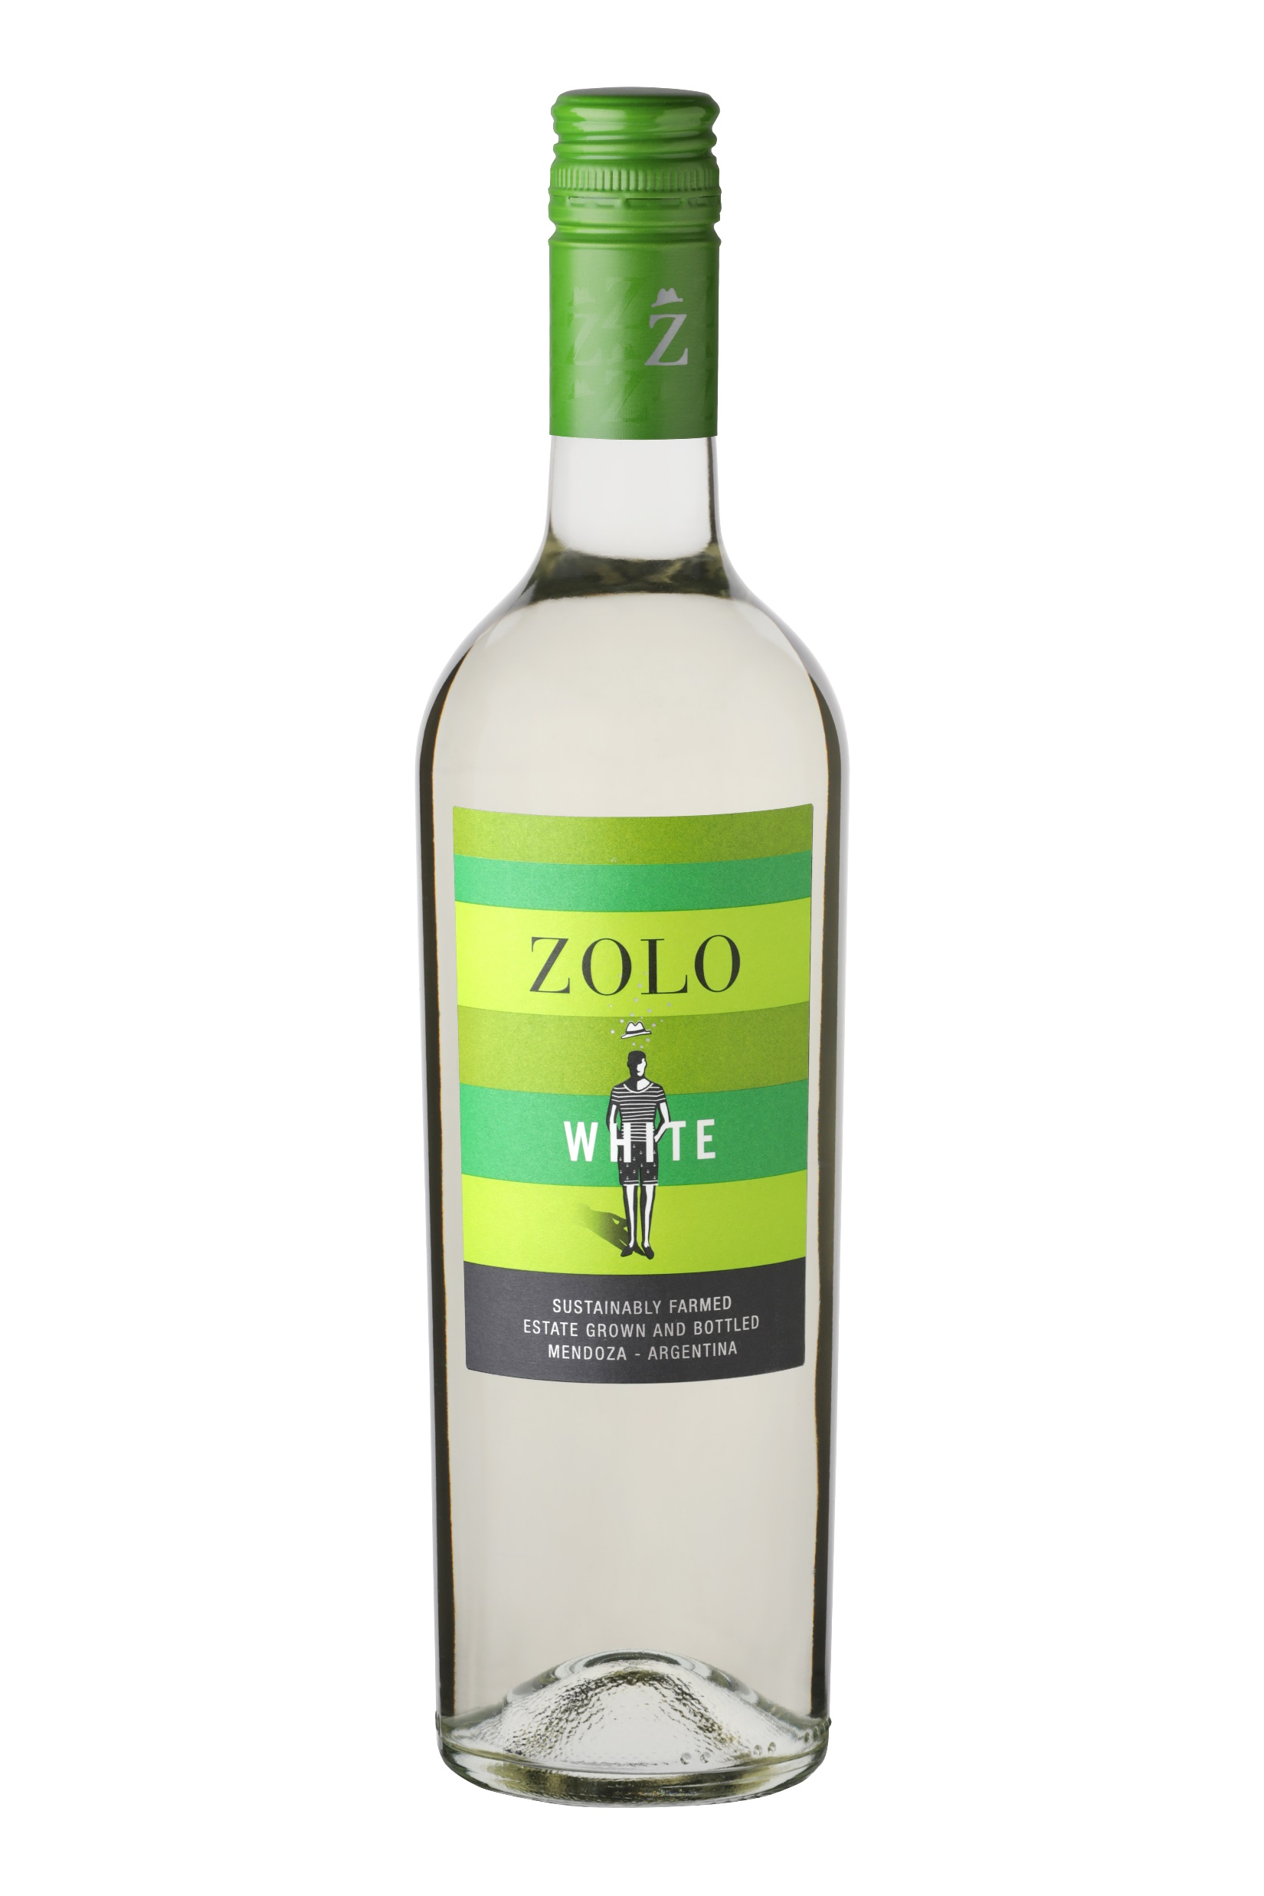

Slide 6

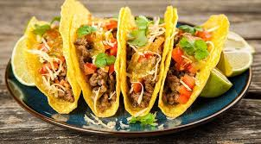
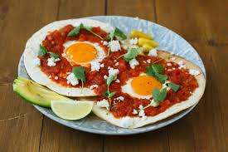
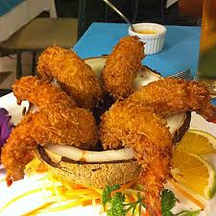
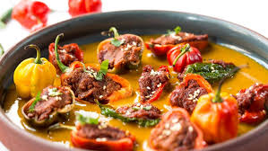
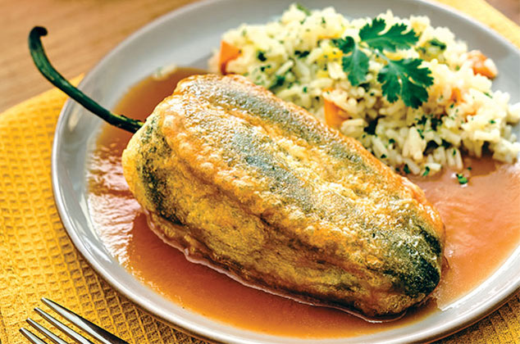
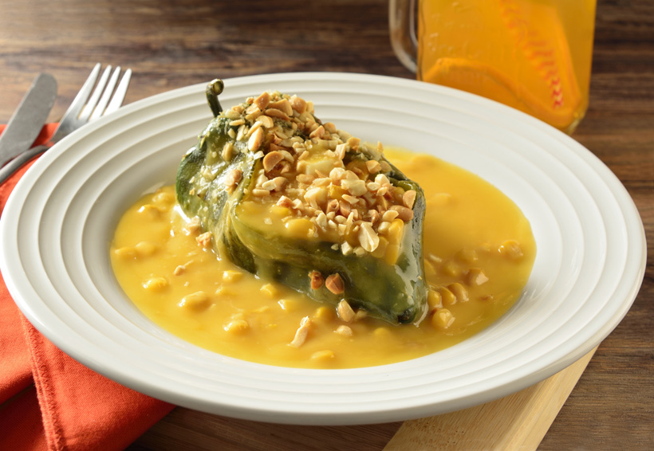
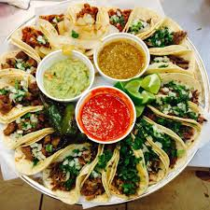

Slide 7
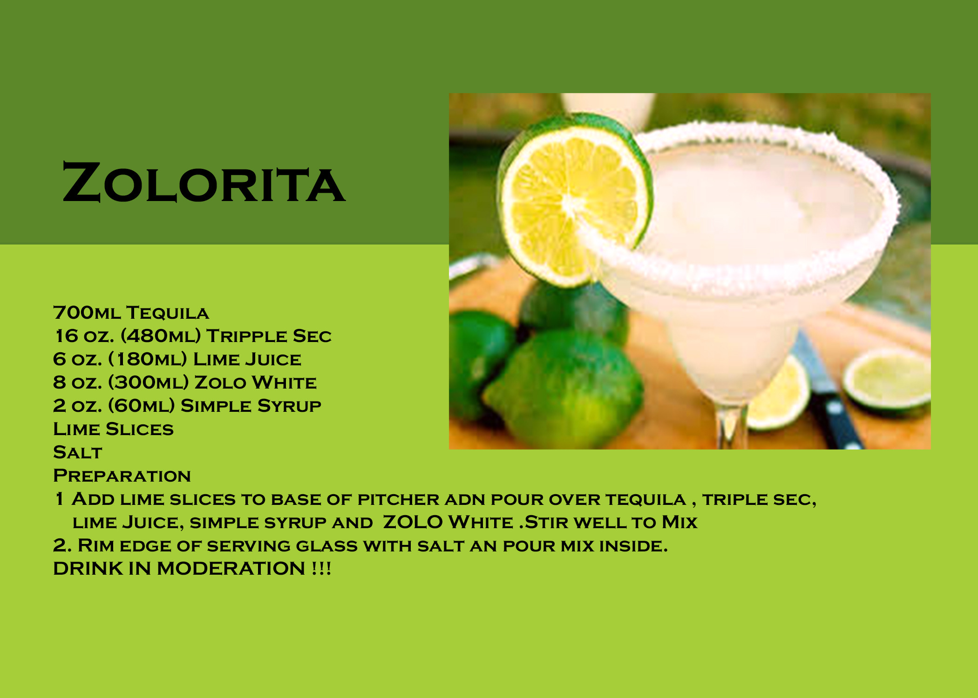

Slide 8
