Slide 1
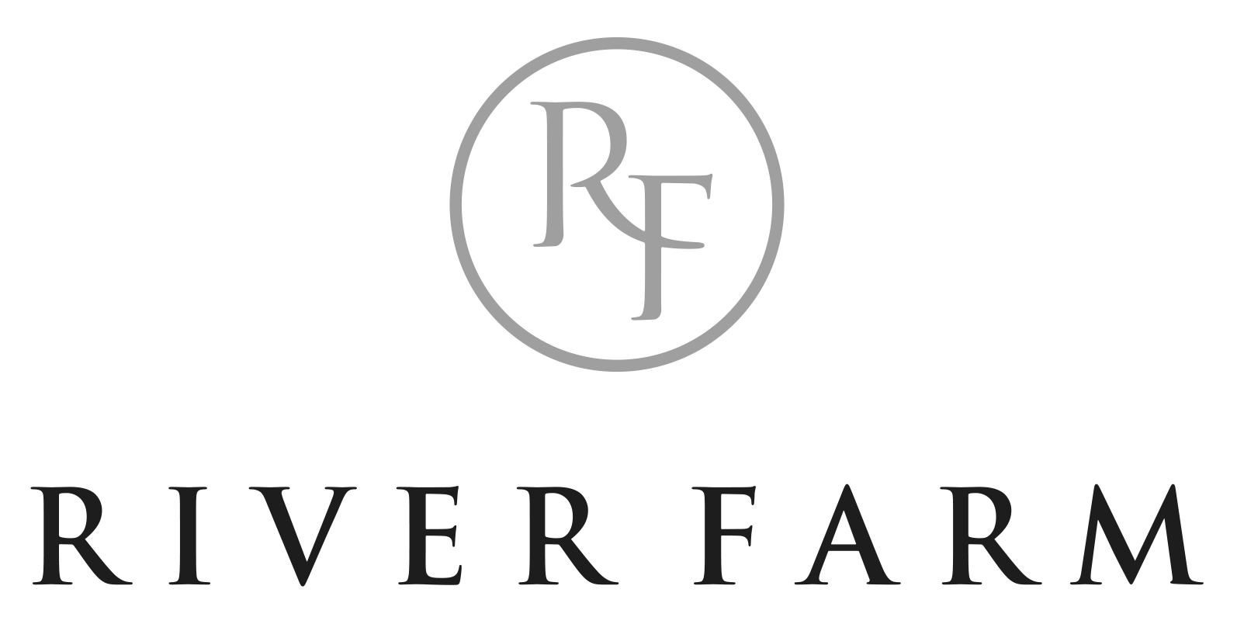
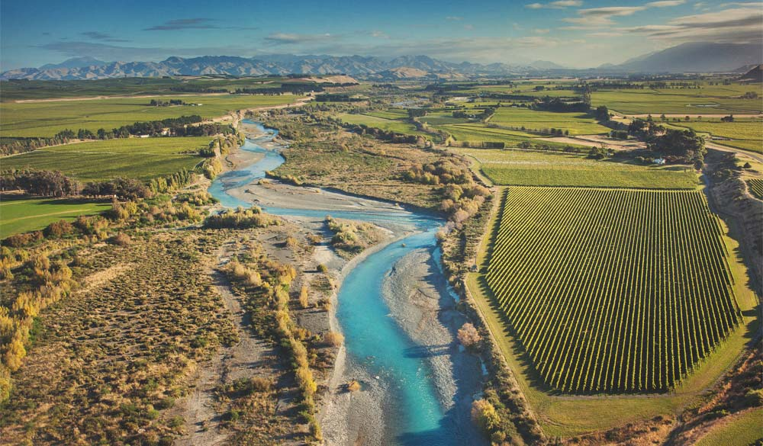
Created by Nature, Perfected by Nurture™
Brand Presentation March 2023

Slide 2
Proudly Family Owned.
Four Generations Working the Land
River Farm Wines is owned and operated by the Jones family who first purchased Marlborough land in the late 1800s; long before anyone knew of its wine growing potential.
Today the family has dedicated 330 acres of their best sites to grape production. The ability to source 100% estate grown fruit from three separate vineyard locations within the Awatere and Wairau sub-regions
River Farm is run by brothers James & Andrew – the 4th generation of the Jones family on the land. Their meticulous attention to detail in the vineyard is expressed in every glass of River Farm wine.

Slide 3
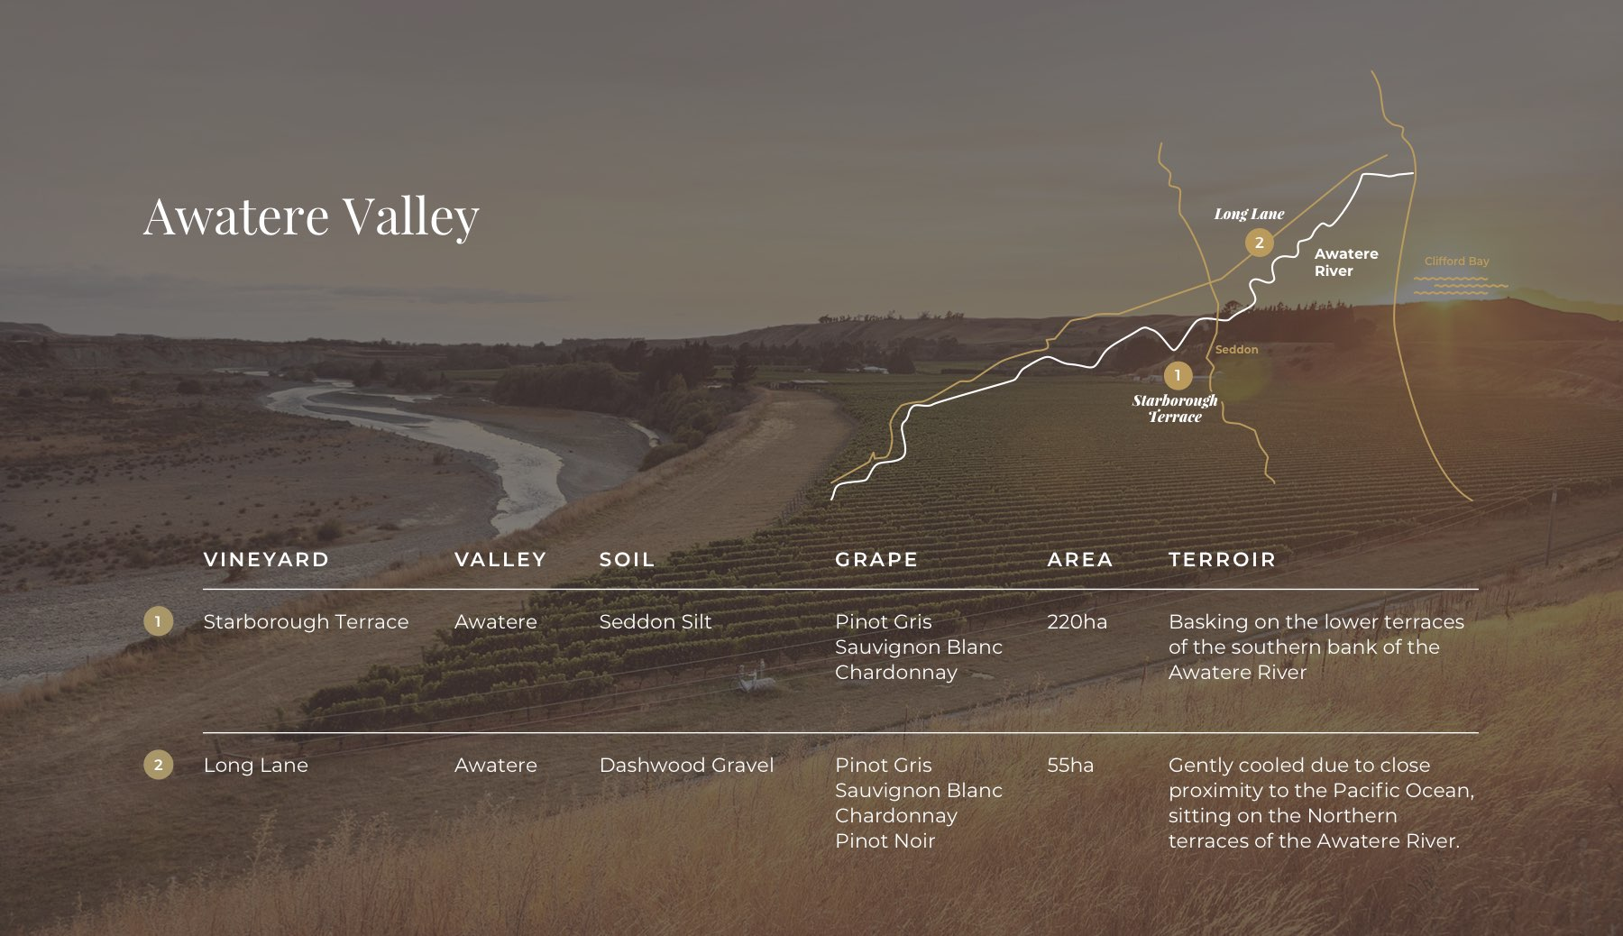
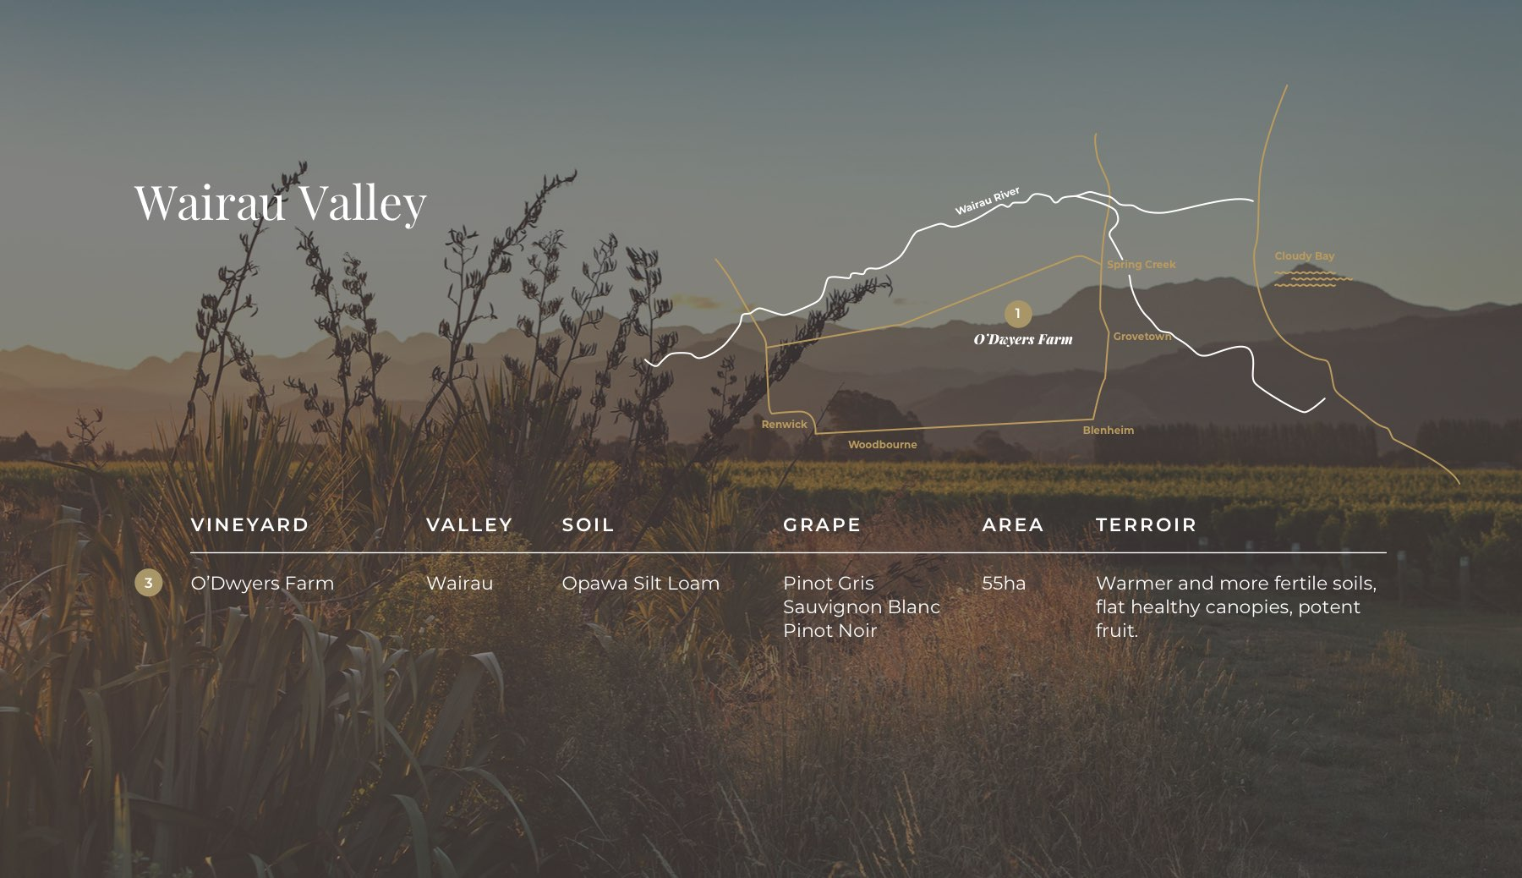
The Vineyards
River Farm is fortunate to have family owned vineyards in both the Wairau and Awatere Valleys. Although both valley’s are located in Marlborough they each have differences in soil and climate forming their own unique characteristic fruit flavours.
The Awatere Valley is generally cooler, drier and windier than the Wairau Valley. Fruit grown at O’Dwyers Farm Vineyard therefore experiences a very different climate to the two Awatere Valley vineyard locations. These differences are reflected in the very distinctive wines produced at each vineyard and when blended together allow a wide range of fruit characteristics in all River Farm wines.

Slide 4
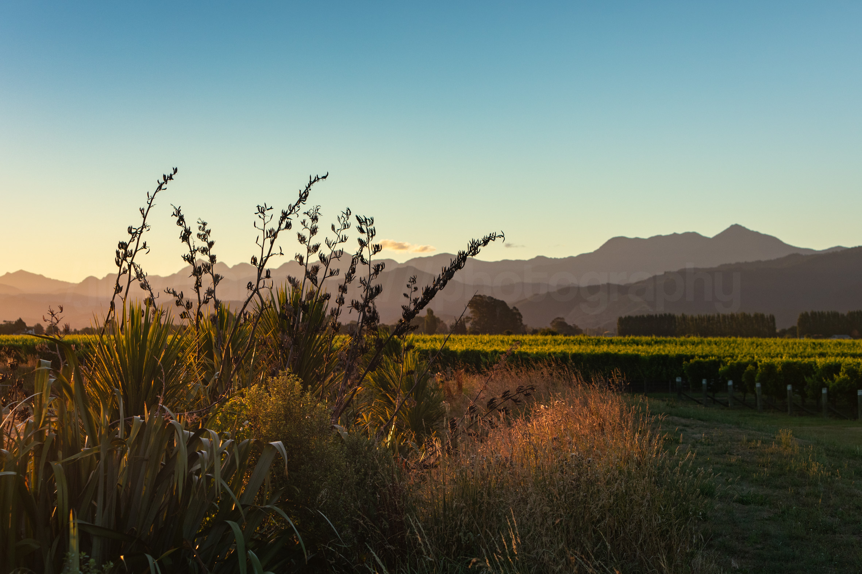
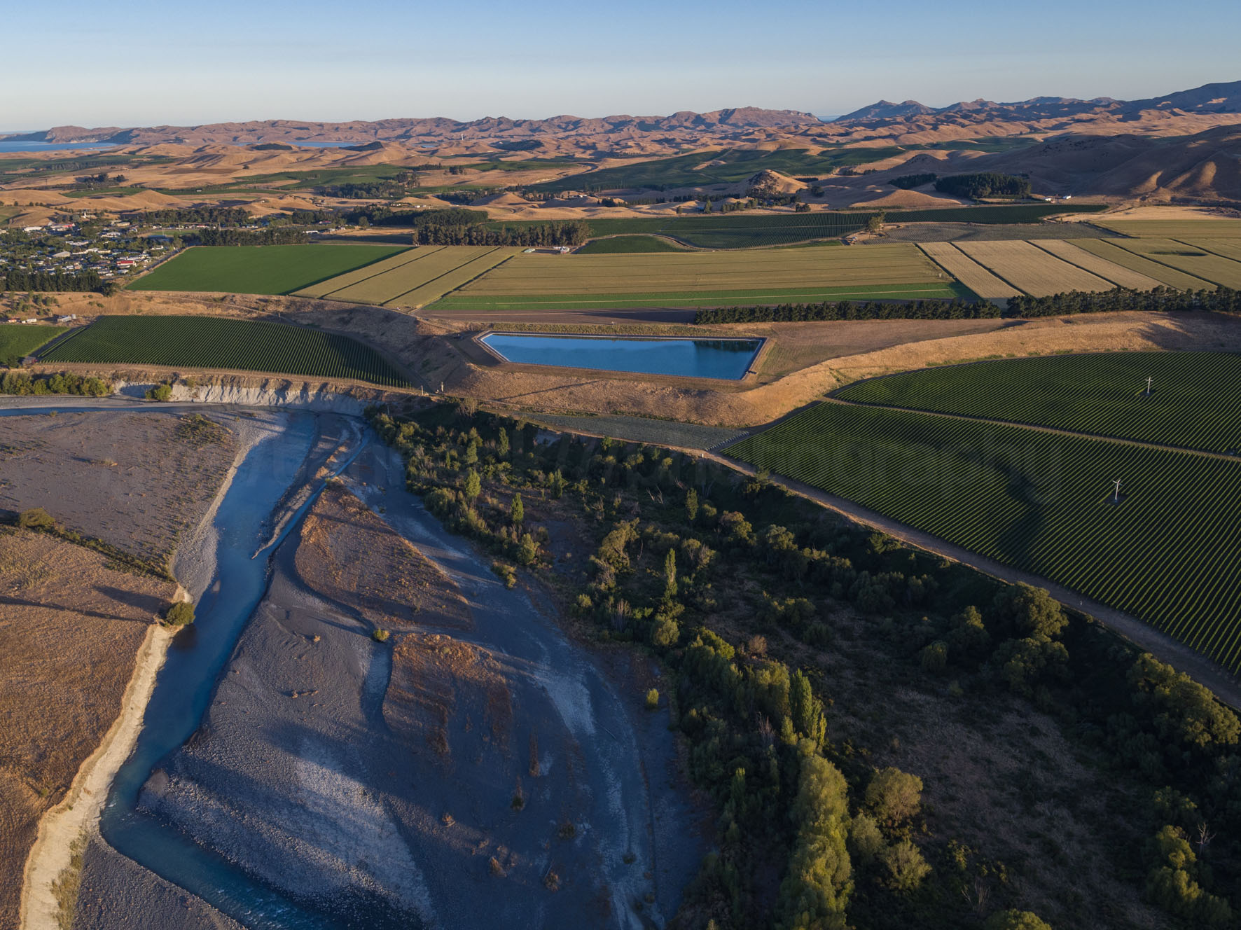
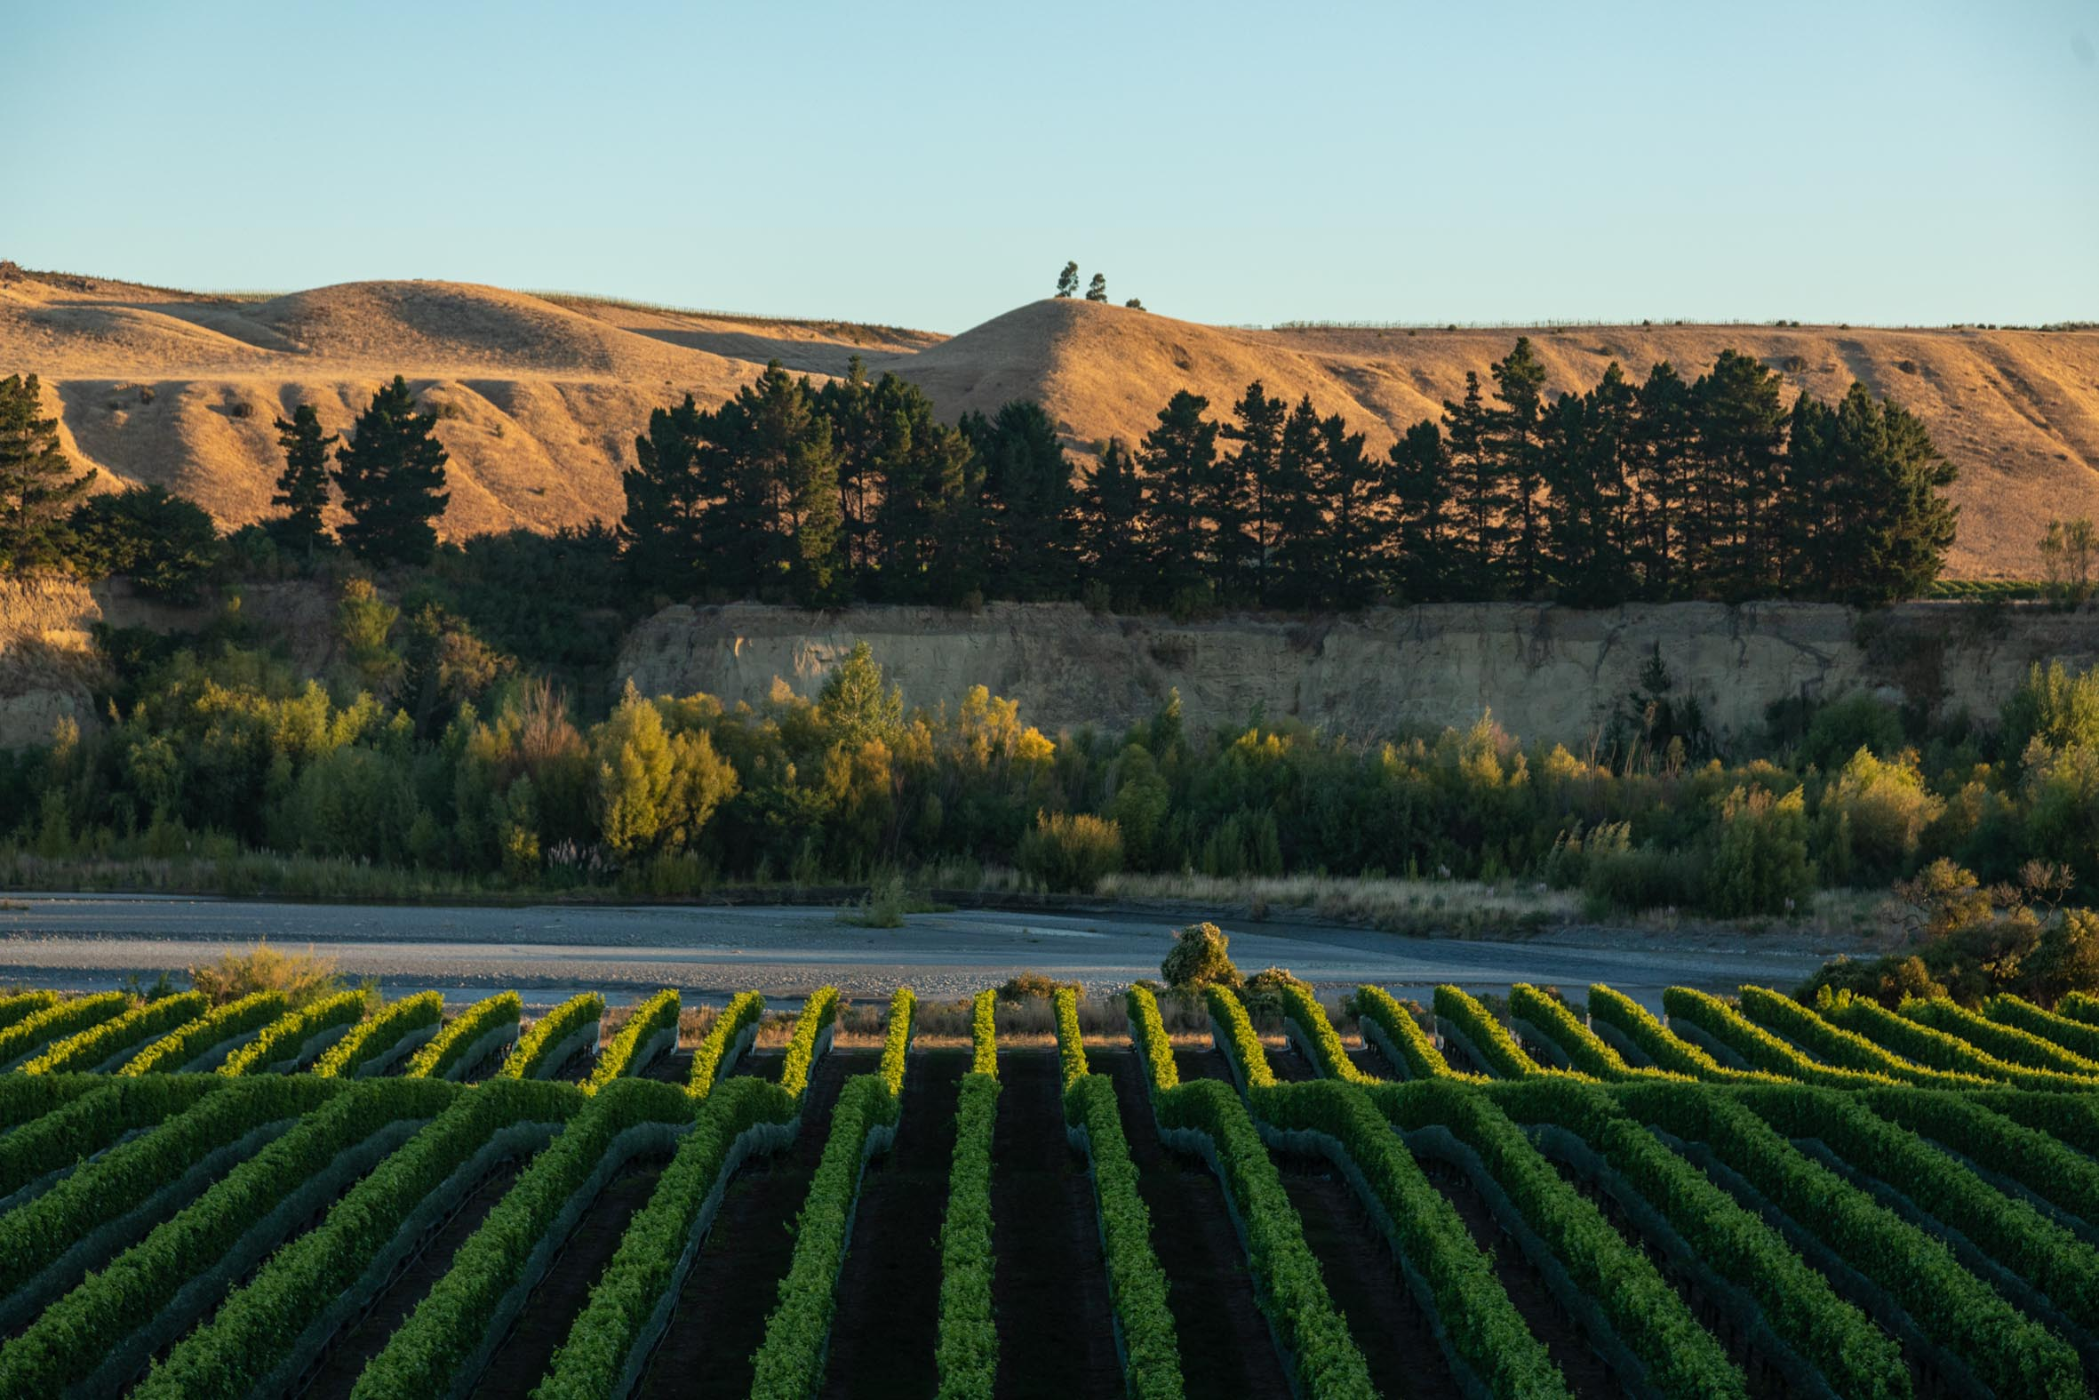
O’Dwyers Farm Vineyard, Rapaura, Wairau Valley
O’Dwyers Farm is the Jones family’s original property in the heart of the Wairau Valley located in Rapaura. Very fertile, free draining, alluvial silt loam soils allows the production of very healthy vine and canopy growth.
This vine vigour, aided by the relative warmth from the valley floor create potent and powerful fruit forward Pinot Noir, Pinot Gris, and Sauvignon Blanc wines.
O’Dwyers Farm Vineyard
(Left)
Sauvignon Blanc
Pinot Gris
Starborough Terrace Vineyard (Right)
Sauvignon Blanc, Pinot Noir , Pinot Gris
Starborough Terrace
South Bank, Awatere River Valley
Nestled between the the township of Seddon and the sunny terraces of the southern bank of the Awatere River, the Starborough Terrace Vineyard is perfectly located to enjoy all the great fruit characteristics of the Awatere Valley.
The soils are formed by wind-blown loess overtop of alluvial stony river gravel deposits. These soils are of moderate fertility and very free draining making them ideal for producing, rich, ripe and concentrated Sauvignon Blanc and Pinot Gris and our Abel clone Pinot Noir.
Long Lane Vineyard
North Bank, Awatere River Valley
Located east of Starborough closer to the sea means this vineyard is cooled by the easterly wind directly off the Pacific Ocean. This cooling allows extended fruit maturity and development creating ripe fruit characters while also retaining refreshing and focused acidity.
The lower Dashwood soils on the northern bank of the Awatere River are alluvial gravel silt loams over deeper layers of river stone deposits. These soils are of low to moderate fertility and are very free draining. The unique interaction between soil and climate produces intensely aromatic, ripe and concentrated wines.
Long Lane Vineyard (Left)
Sauvignon Blanc, Chardonnay, Pinot Noir, Pinot Gris

Slide 5
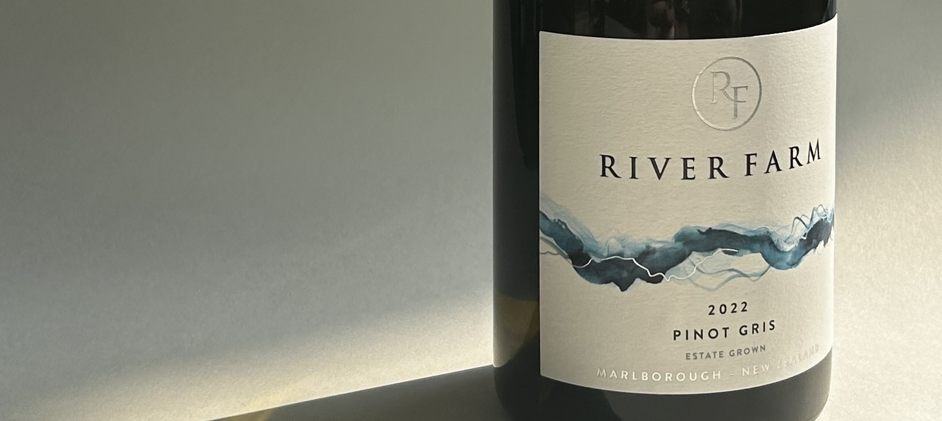
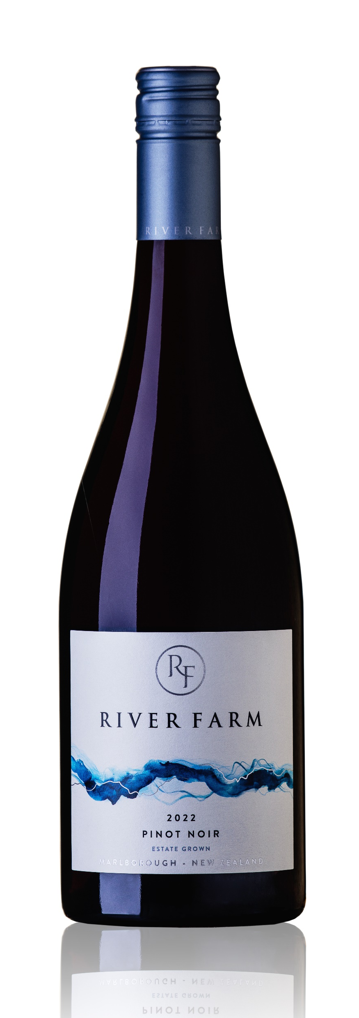
The Wines
The crystal clear water of the Awatere River is the life blood of River Farm and the source for the alluvial soils that give the wines their
unique character.
2022 River Farm Sauvignon Blanc Marlborough - Wairau 40%, Awatere 60%
Beautifully lifted on the nose with gooseberry, kar lime, apricot and
lemon peel aromas. is leads to a delightfully flavoursome palate
delivering excellent fruit intensity and vibrant acidity, making it
instantly appealing.
93 Points, 5 Stars – Sam Kim, Wine Orbit
2022 River Farm Pinot Gris,
Marlborough - Wairau 60% & Awatere 40%
Concentrated white peach, nashi pear and quince with floral notes, a touch of spice and chalky minerality on the nose. 10% was fermented in seasoned oak barrels and 5.0g/l of residual sugar have created an elegant, textural palate. The palate shows apricot and ripe pear and nectarine with a hint of mandarin peel and balanced refreshing acidity producing a long finish.
90 Points, 5 Stars – Sam Kim, Wine Orbit
2022 River Farm Pinot Noir
Marlborough, - 100% Awatere
Stylish and elegant with red cherry, raspberry and plum fruit, a subtle hint of cloves, roasted chestnuts and some dried herbs. The succulent palate has more intense red fruit with Black Doris plum, dried cranberry and thyme. This is a well-structured wine with fine grained tannins and pleasing mid palate weight, supported by a long, lingering finish with savoury, toasty oak. The wine was aged in new (20%) and seasoned oak barrels for 11 months
93 Points, 5 Stars – Sam Kim, Wine Orbit

Slide 6
