Slide 1

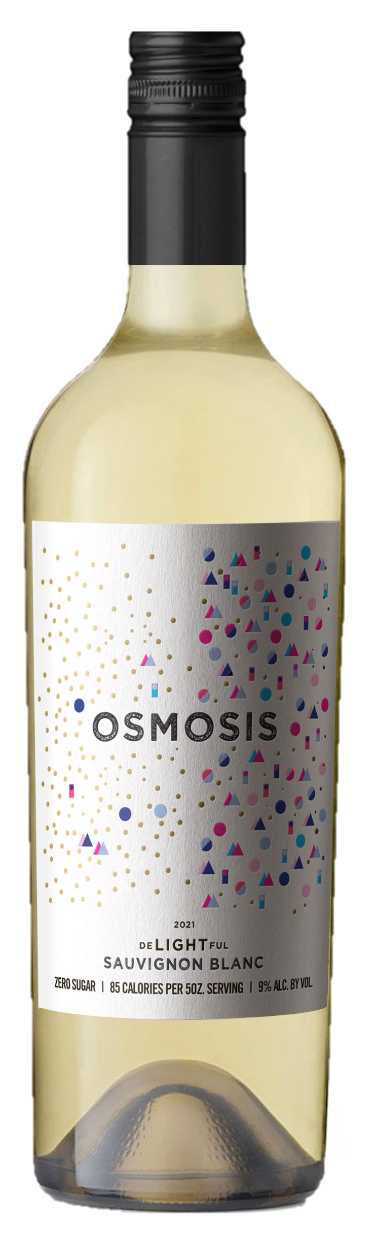


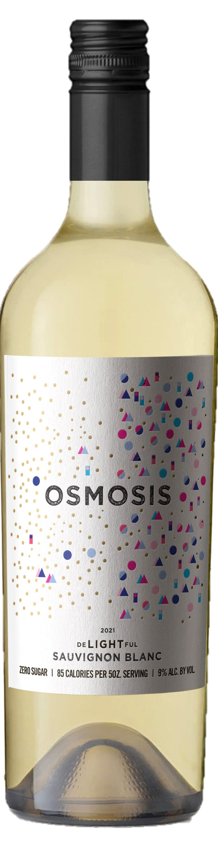
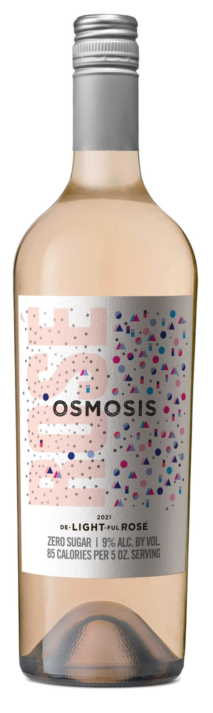
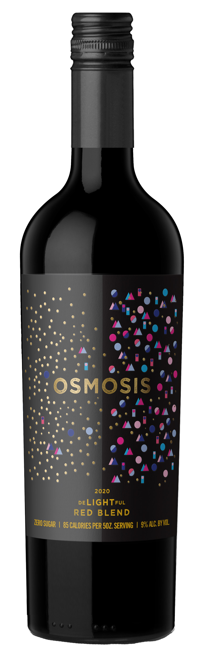






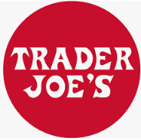


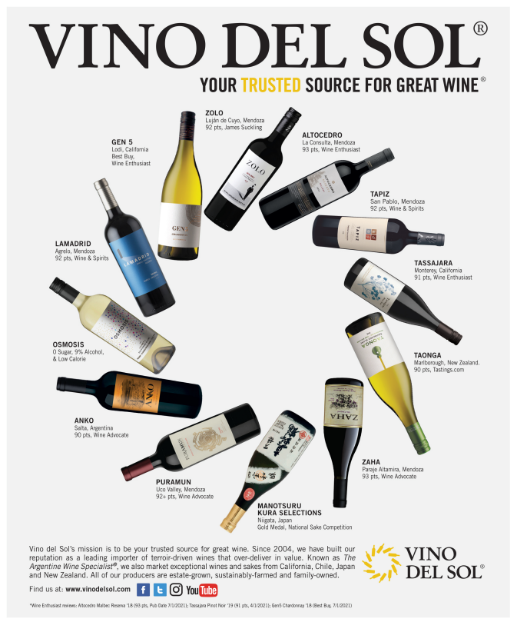
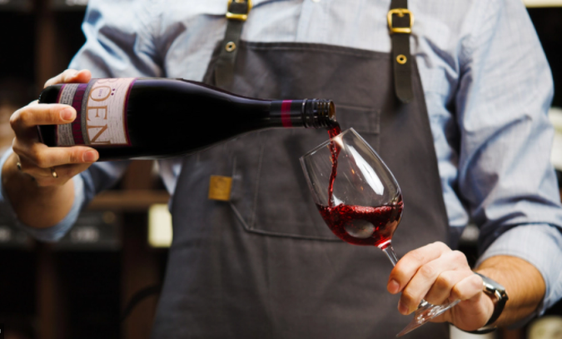


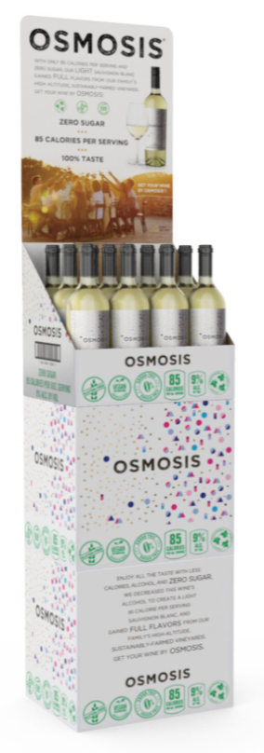
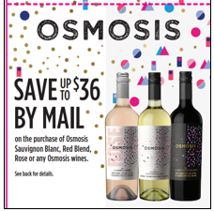

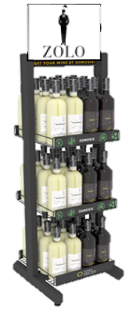
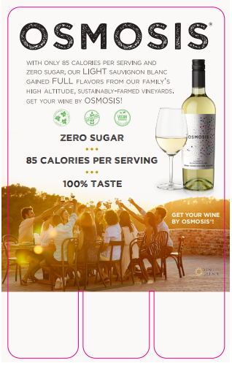
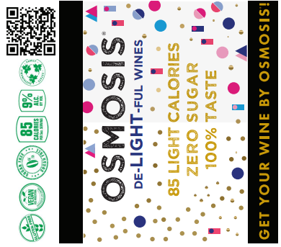
REASONS TO BELIEVE
“Low-calorie wines are well-positioned, having more than quintupled the past three years [the leading brands account for over 2 million cases sold in 2022].”
-U.S. Wine Market: Shanken’s Impact Databank Review & Forecast 2023
OSMOSIS was born to meet the concerns of today’s consumer and fit with their health-conscious lifestyle. Osmosis is the best tasting, Low Calorie wine, delivering all the taste with less of the things you don’t want.
85-90 Calories,
Zero Sugar, Vegan,
Reduced Alcohol,
Woman Owned,
Estate Fruit and
Sustainably Farmed
Great Tasting Varietals targeted in HOT varietal categories: Sauv Blanc, Red Blend and Rose
Wine Trade Endorsements:
Retail Taking Notice:
Attributes listed on back label-
easy for shoppers to identify
INVESTMENT/ SUPPORT
Social
Advertising
Print and digital
Demos
IRC and MIR Support
QR Code Tech
POS/ Display
*2023 Nielsen IQ
Notes:
Priority Order- Sauv Blanc, Rose, Red Blend
Osmosis Reviews
Eric Hemer, MW/MS tasted the Osmosis Red and Rosé: His Notes Below
De-LIGHT-ful ROSÉ 2022 – Zero sugar, 9% ABV, 85 calories
“Medium watermelon pink color; clean and fresh on nose, notes of ripe summer fruits, peach, raspberry, watermelon, light, herbaceous note. Dry, medium-bodied, similar fruit profile on palate, tart, tangy, crisp acidity, balanced alcohol, a touch of chalky minerality, long, clean finish. Very well-made and satisfying. I don’t miss the extra 3-4% alcohol.”
De-LIGHT-ful RED BLEND 2021 – Zero sugar, 10% ABV, 90 calories
“Deep purple, opaque color; pronounced dark fruit on nose, black plum, black cherry, hint of cassis, touch of mocha, new oak indicator; on the palate, medium-plus body, the fruits turn a bit tart and manifests more as red than black fruit; raspberry, cherry, red plum flavors, hint of loamy/chalky earth. Medium tannin and acidity, balanced alcohol, long, clean finish. Again, very good, satisfying, don’t miss the 3-5% ABV.”

Slide 2
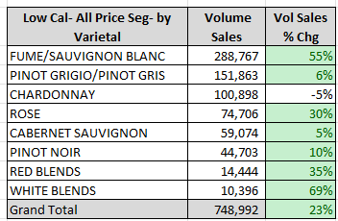
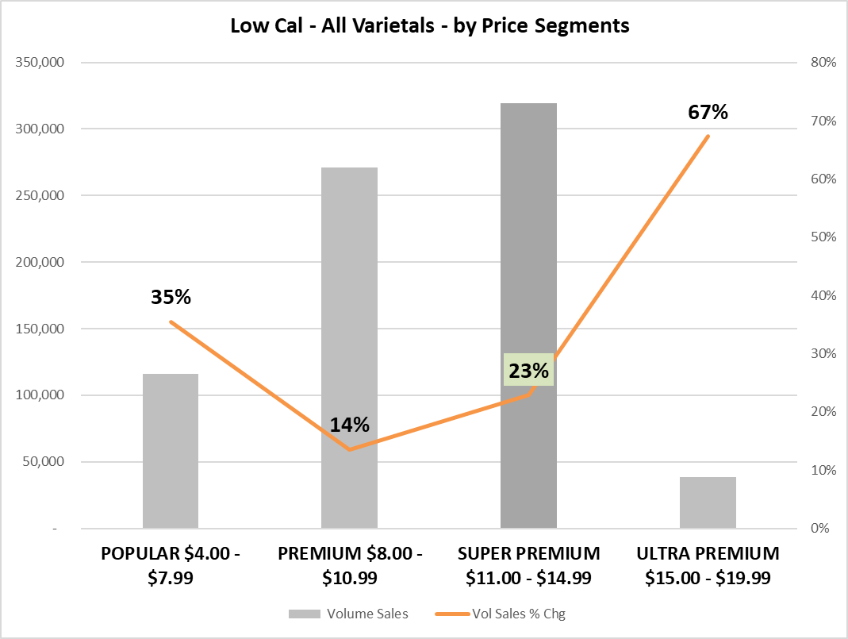
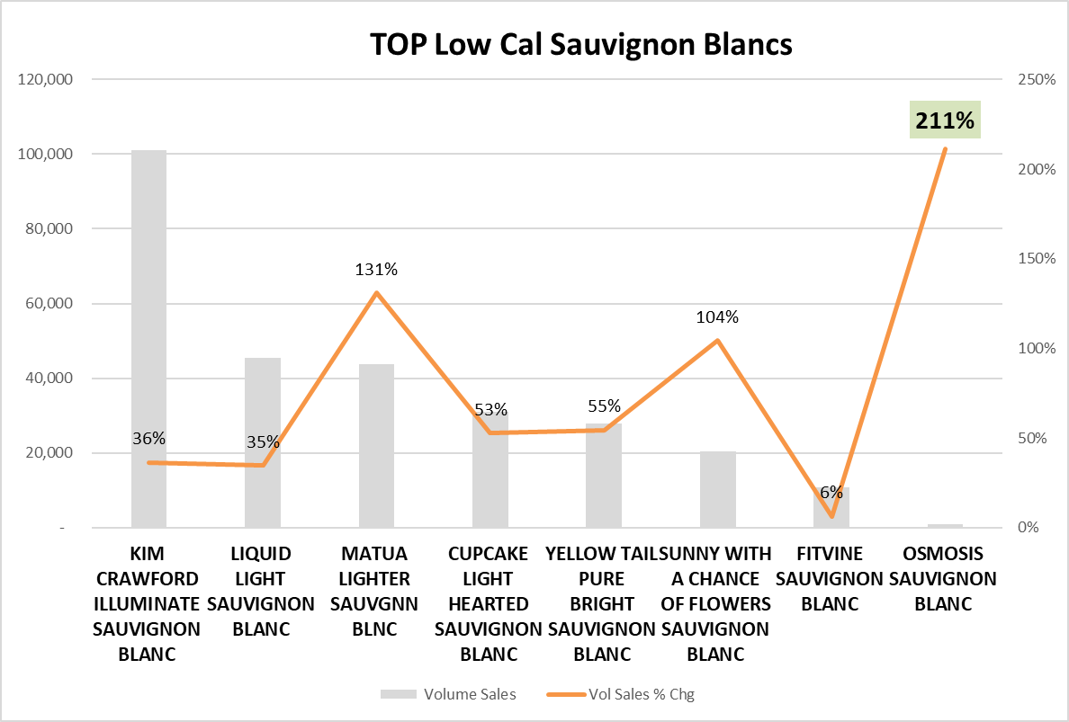
Discover Low Calorie
Low Calorie SKUs continue
growth in year 2, +23%
(IRI Total Table Wine -5% Vol)
IRI alone is posting 750,000 cs in the last 52 Weeks!
Sauvignon Blanc is the clear leader in all price segments.
Rose and Blends are also outpacing the rest!
$11-15 is the sweet spot when it comes to price tiers among shoppers by volume, growing +23%
Osmosis is a NEW addition to chain retail,
up +211%.
Osmosis is a trade Up Opportunity!! Heath conscience consumers will spend more for 0 sugar, Vegan, Low Calorie -Food and Wine!!
IRI 5.28.23 L52 Wks
Notes:
Latest 52 Weeks Ending 05-28-23 : $Sales (-1.4%) Volume (-5.5%)

Slide 3
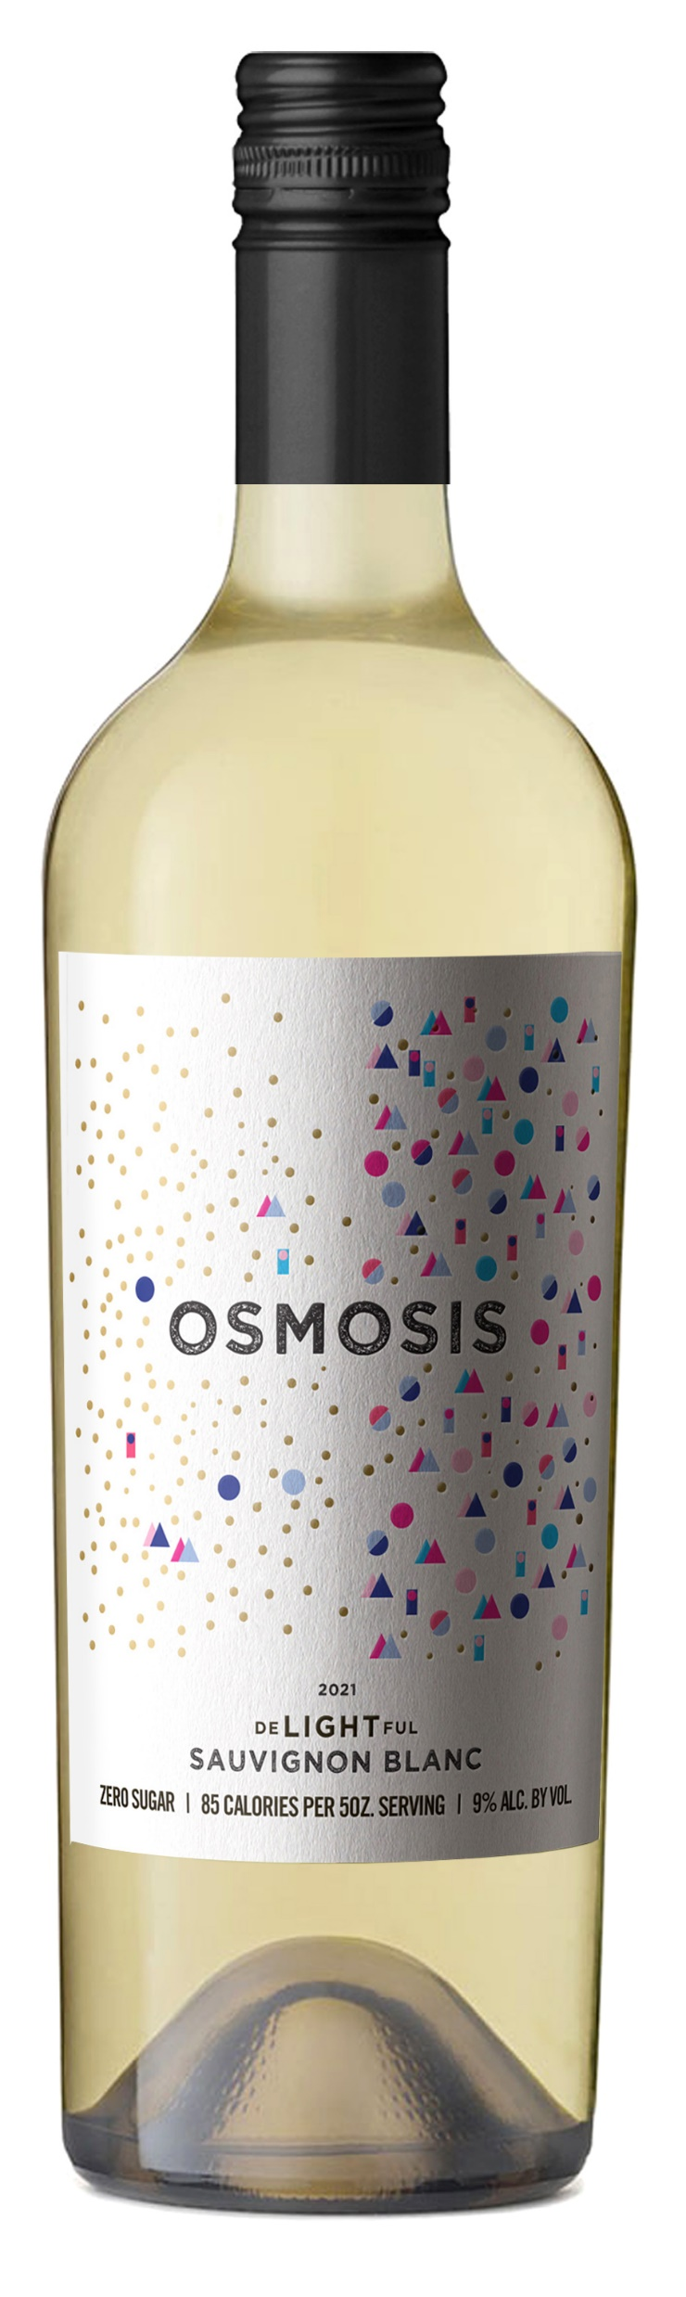
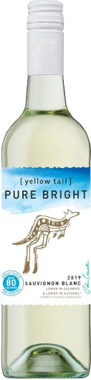
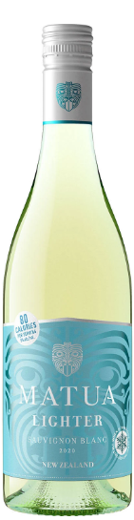
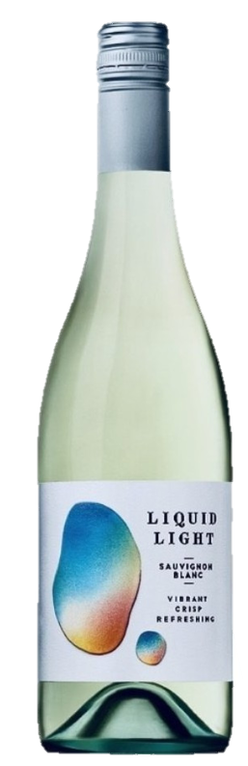
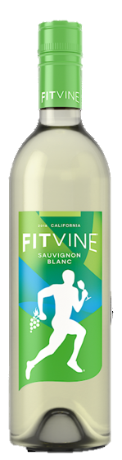
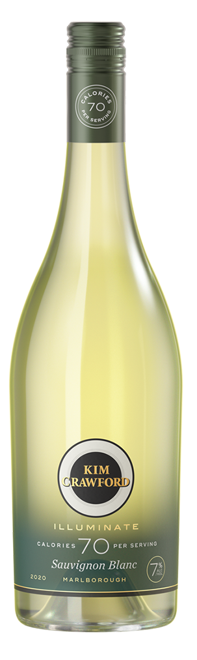
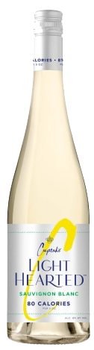
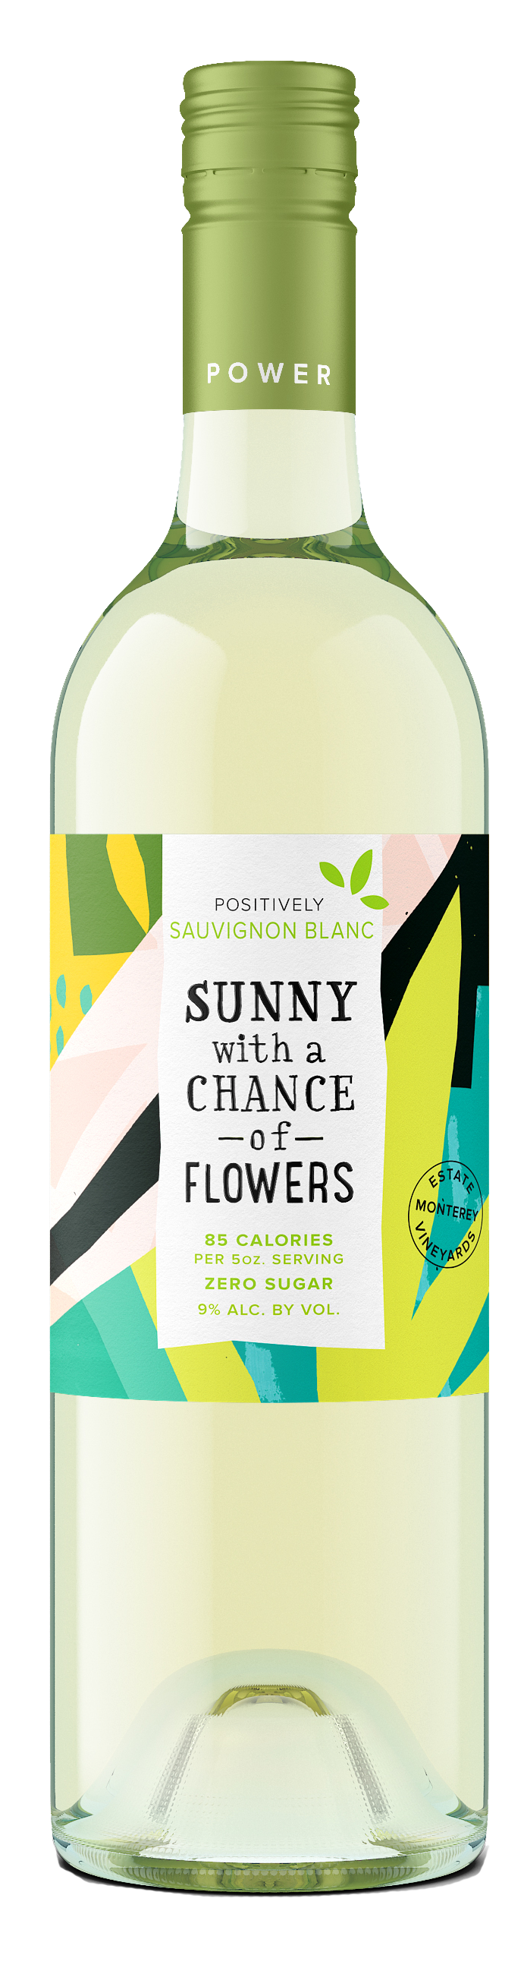
LOW CALORIE- Competitive Set
$6-10.99
$12- 14.99
$15-17.99

Slide 4
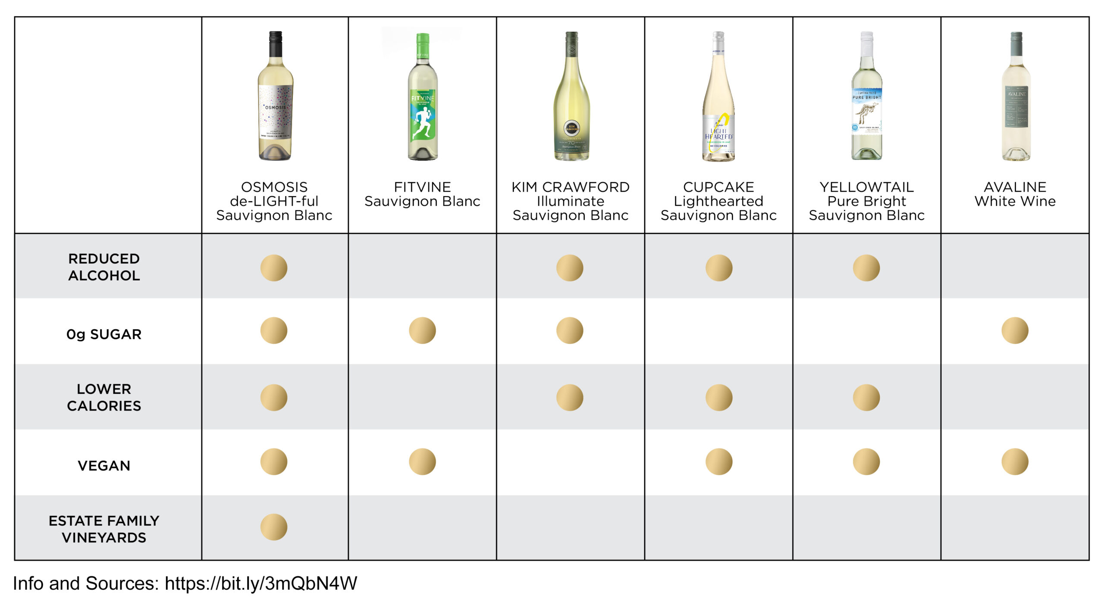
Osmosis: The Best “Better for You” Wines®
Why? (1) We check all the boxes

Slide 5
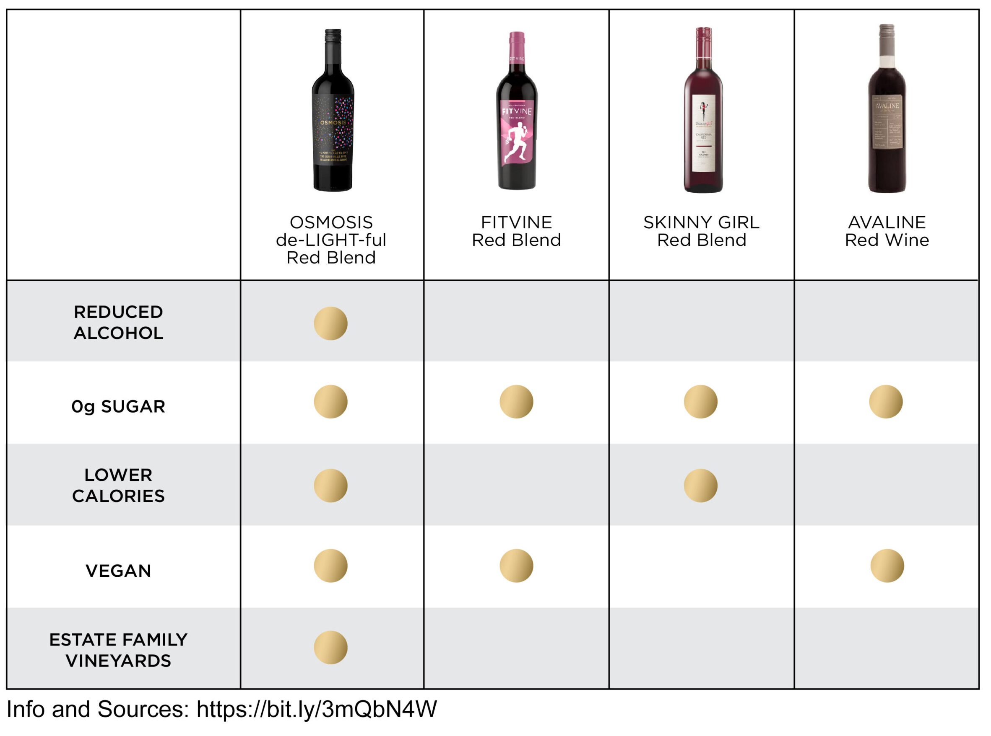
Osmosis: The Best “Better for You” Wines®
Why? (1) We check all the boxes

Slide 6
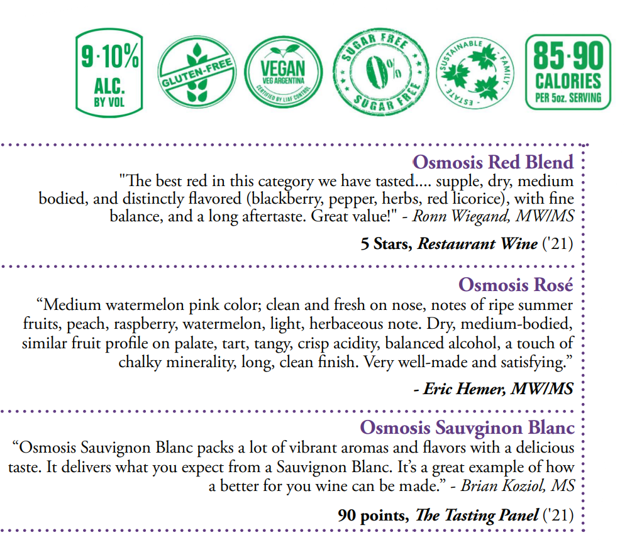
Osmosis: The Best “Better for You” Wines Why? (2) We Taste the Best

Slide 7
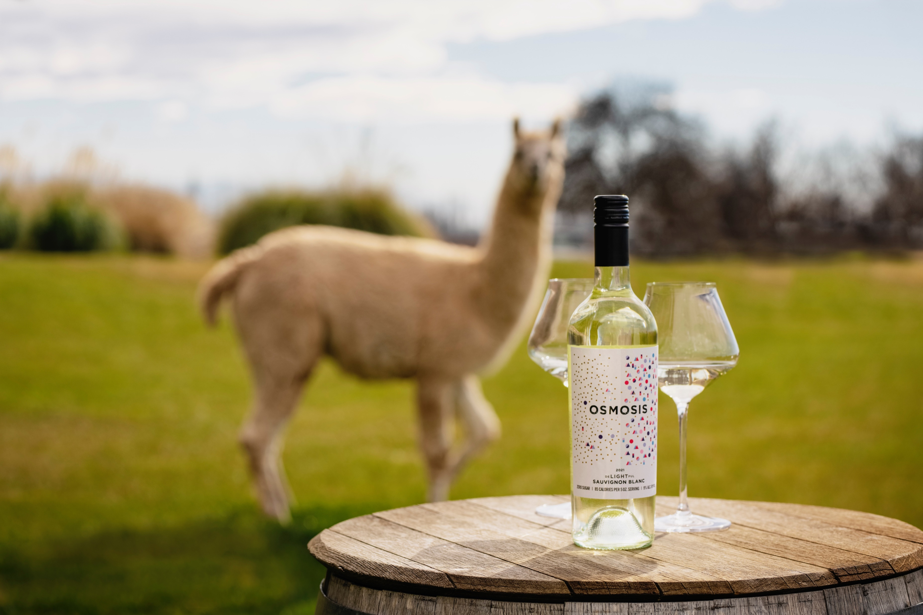
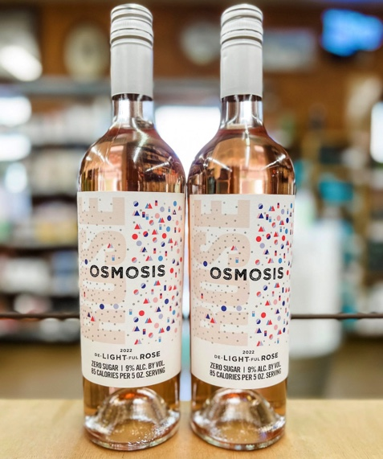
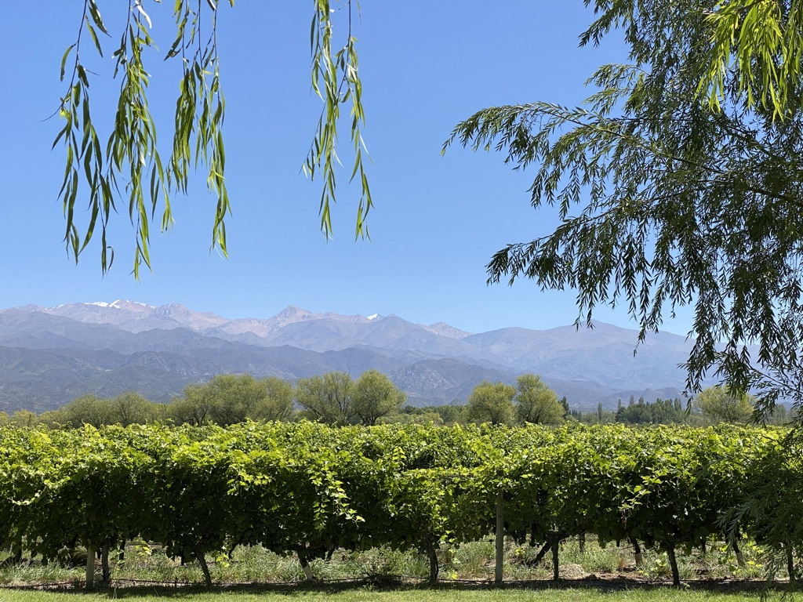
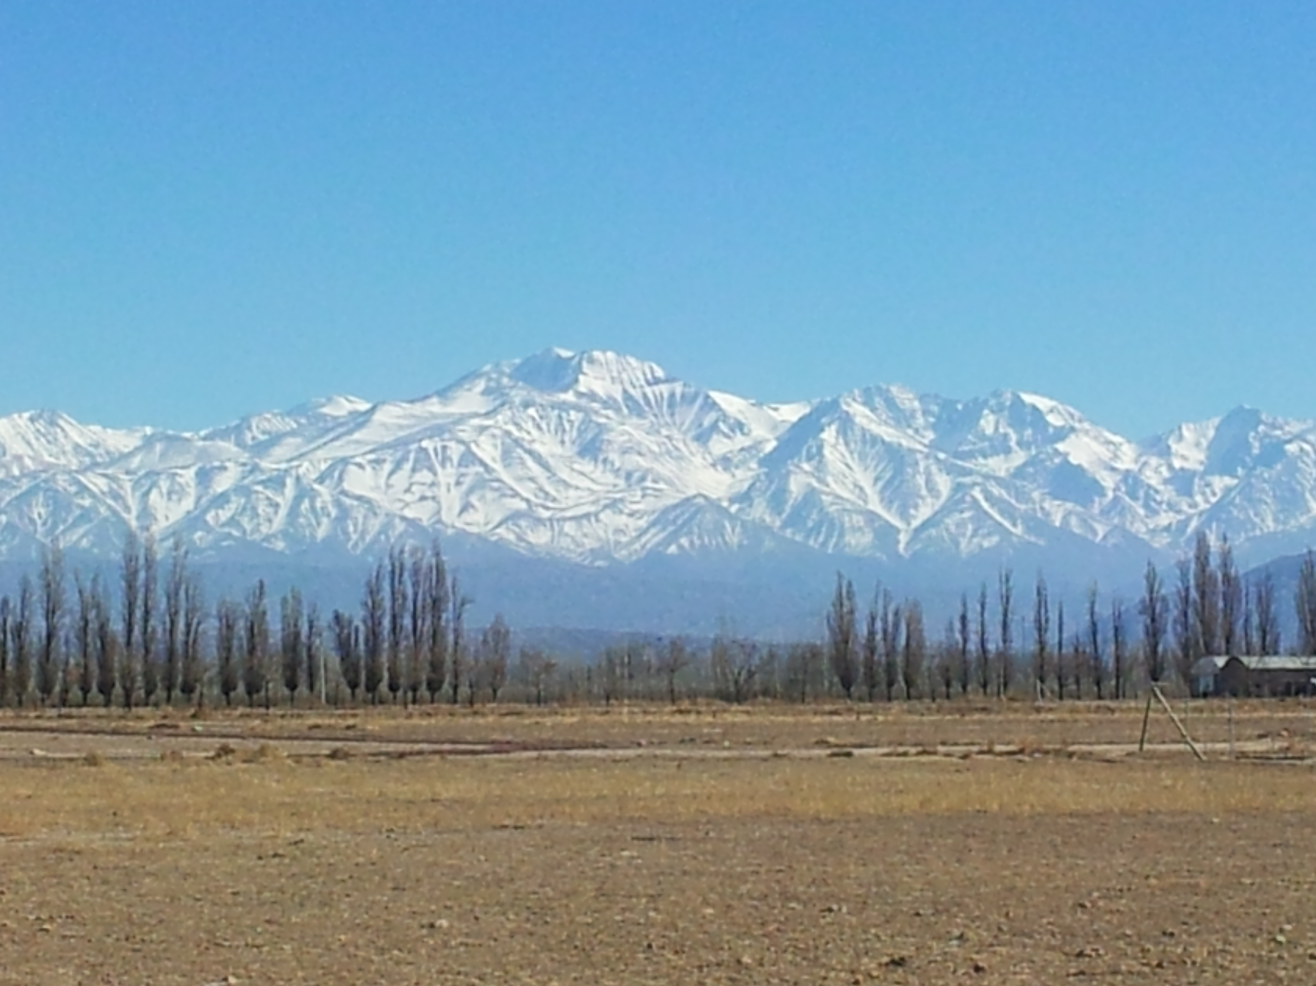
Osmosis: The Best “Better for You” Wines 100% Taste – How We Made Osmosis
Osmosis Wines are:
Estate grown from Family-owned, Sustainable vineyards located in the
High-altitude terroir of the foothills of the Andes Mountains in Mendoza, Argentina.
The Sauvignon Blanc is Hand harvested and picked at 3 different stages then blended:
Early Harvest = lower alcohol and bright acidity
Middle Harvest = floral and fruit notes
Later Harvest = concentrated, ripe, round flavors
The vineyards and winery are woman-owned and woman-run.

Slide 8
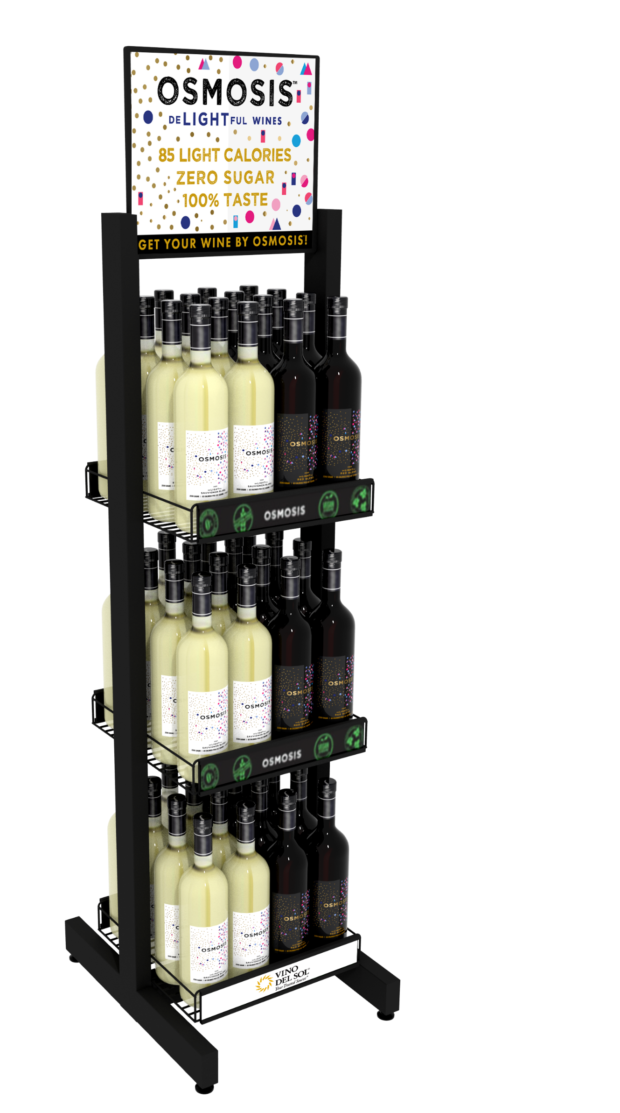
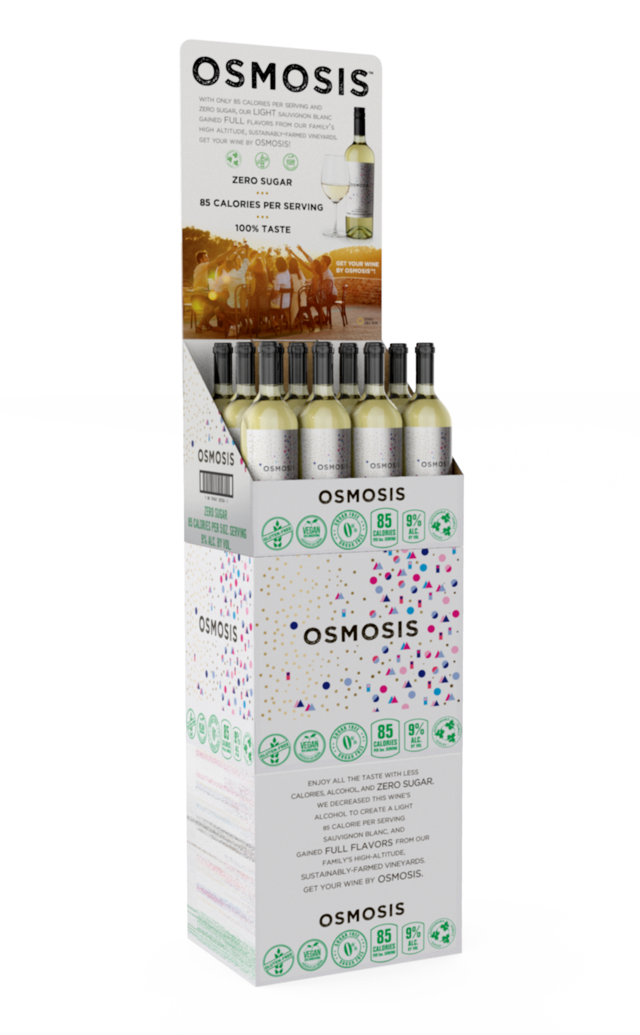
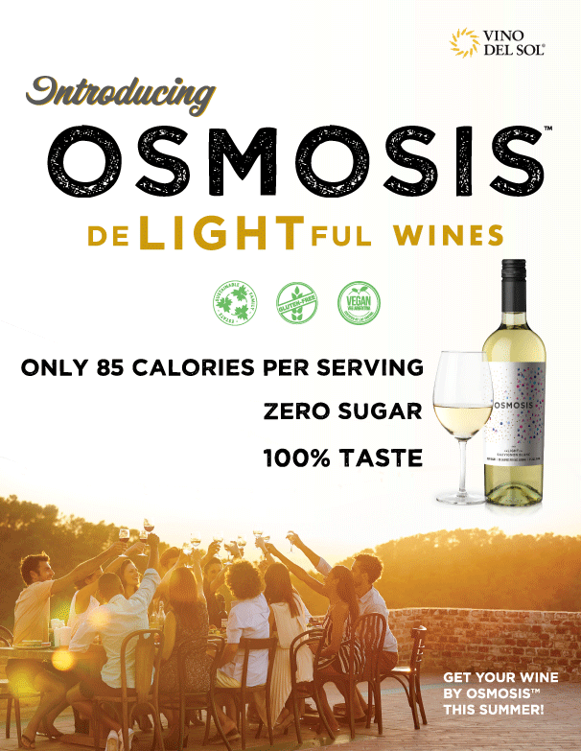
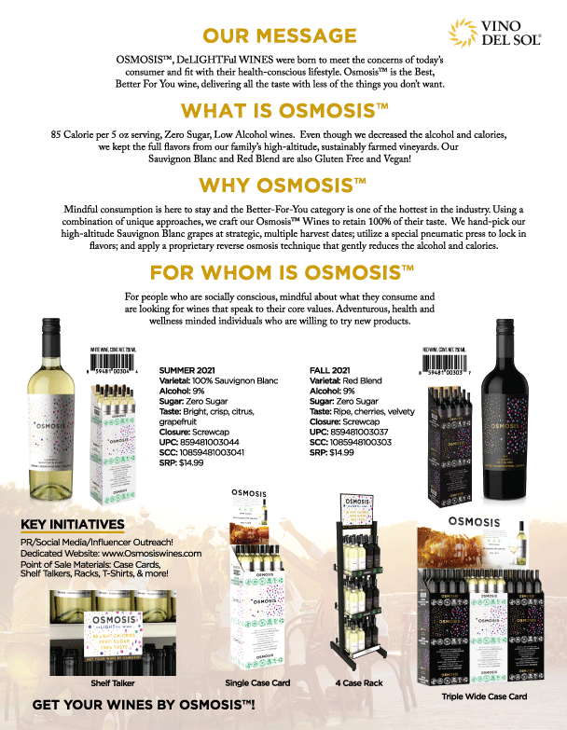
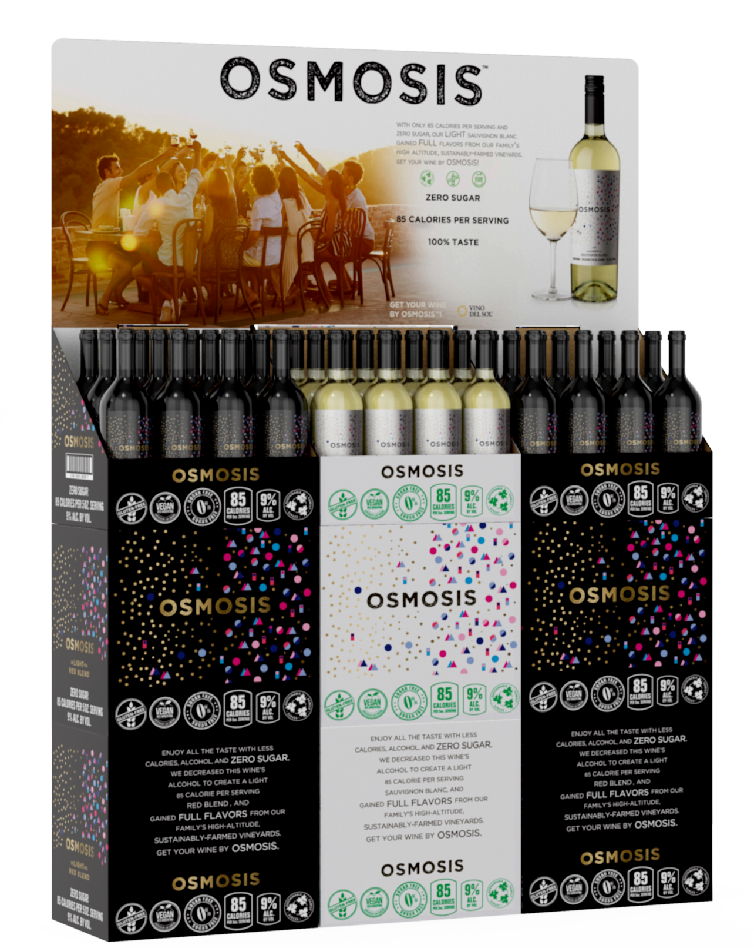
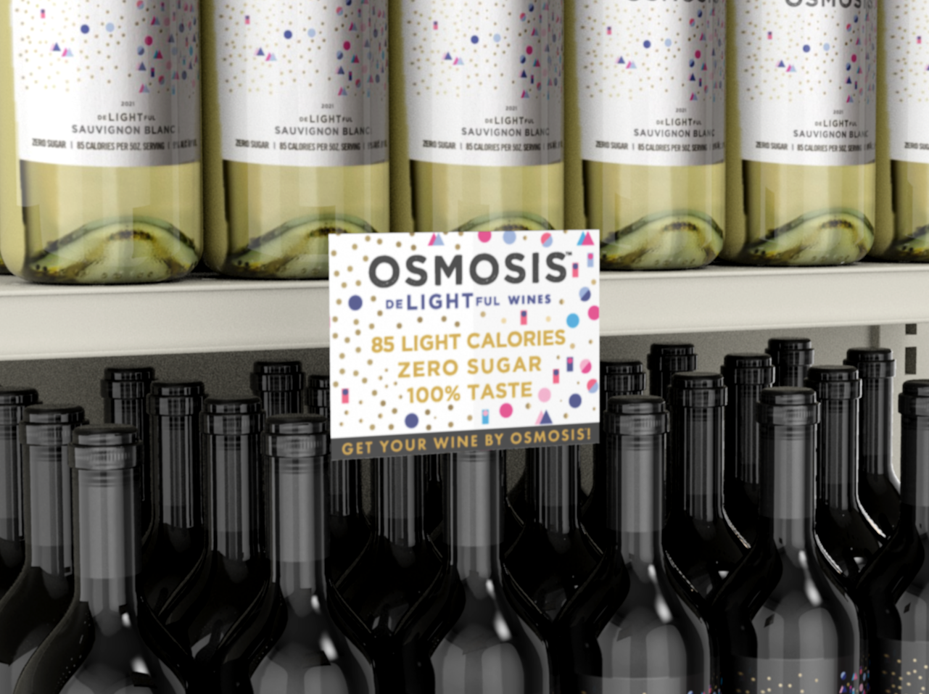
OSMOSIS- Point of Sale
4 Case Rack
Triple Wide Case Card
Single Wide Case Card
Sell Sheets
Shelf Talkers
Notes:
This is very much a retail brand. But on-premise is key too – table tents can be made, inserts…Look towards accounts that feature healthy menus but also mainstream, this will be mainstream! Get your pound of flesh now! Must drive to floor. Attractive, ready-made display with outer shipper, stand out with a rack. Since there is no category on the shelf yet stack on floor. Case cards, shelf talkers and sell sheets in stock or about to be in stock. Sell sheets are in abundance! Racks are going to be in stock soon.

Slide 9
