Slide 1
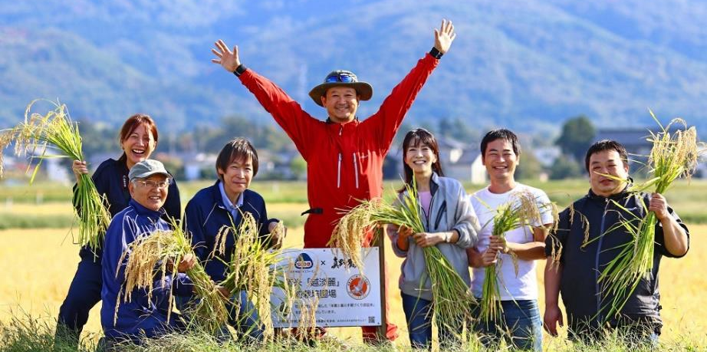
Sake of Sado Island - Manotsuru
Rumiko Obata – 5th Generation

Slide 2
Rumiko Obata
5th generation owner of Obata Brewery
Producer of Manotsuru
Graduated Keio University
Worked for Nippon Herald Movie company in the film industry
Returned to Sado and took over the brewery in 1995
Selected as one of 55 “Local Innovators” by Forbes Japan
Winner of the “Active Women of Niigata” award
Selected as representative for Japan Cabinet Office’s “Supporting Active Women” project
Winner of the Japan Times “Satoyama Award”
WSET Sake Level 3
Official Sake Taster (National Research Institute of Brewing)
Visiting Researcher of Tokyo University IFI(Institute for Future Initiative)

Slide 3
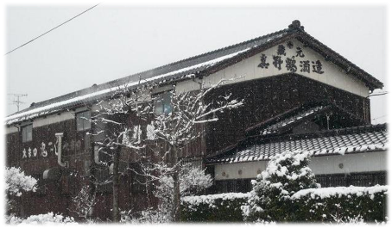
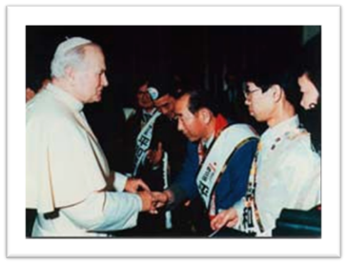
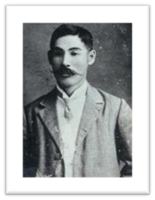
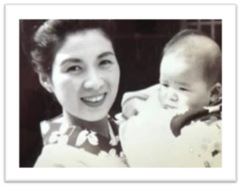
OBATA SHUZO
尾畑酒造
Established in 1892
Founder Yososaku Obata
Sadako & Rumiko Obata
Shunichi Obata

Slide 4
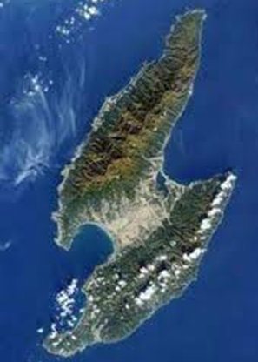
Sake and Terroire
About 1500 sake brewery in Japan
SADO ISLAND
50,000 people
5 Breweries
NIIGATA PREFECTURE
88 Breweries (#1 in Japan)
Lake Kamo (Oysters)
Kuninaka Plain (Rice)
Obata Shuzo
Shoryu
Rice Terrace
Gakkogura (2nd Brewery)

Slide 5
Sado and the world
Sado
38

Slide 6
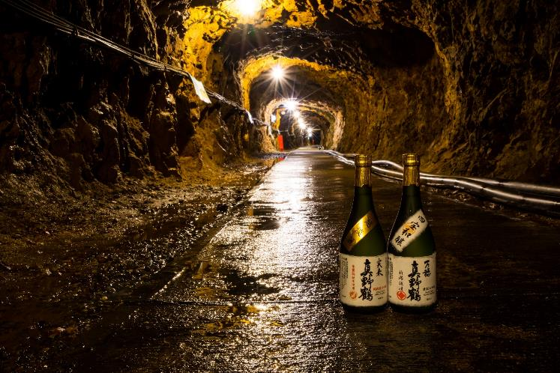
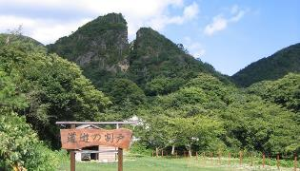
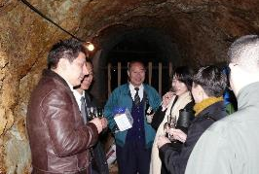
HISTORY of Sado island
Sado Gold mine was
the source of prosperity for the Edo shogunate
Sake storage (aging) in the old tunnels

Slide 7
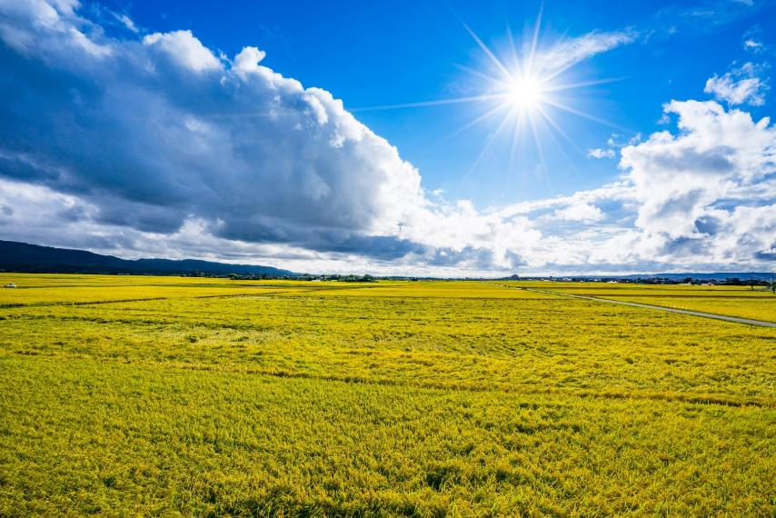
Rice 米
Niigata is number one rice growing region
Sado rice is world- renowned brand
Rice fields on the Kuninaka Plain

Slide 8
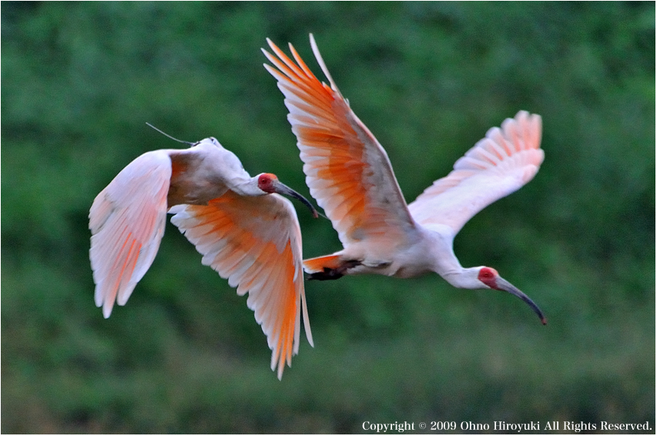
Toki (Crested Ibis)
The Symbol of Biodiversity
Classified as endangered species Current wild population: approx. 550

Slide 9
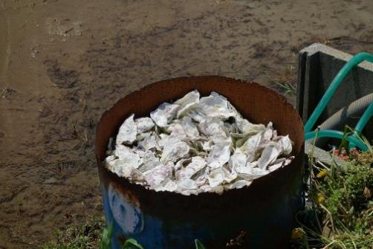
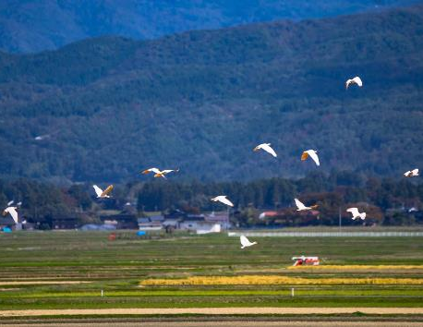
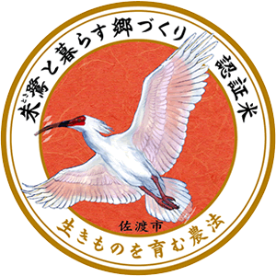
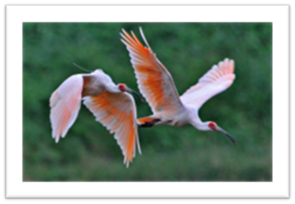
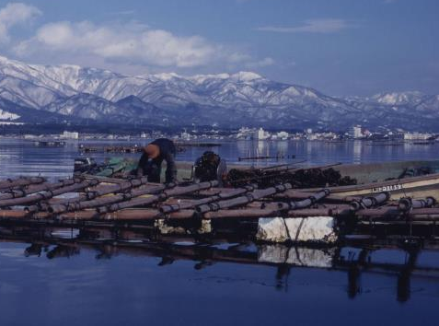
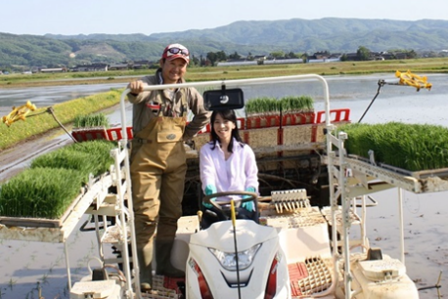
Oyster shells used for the rice fields
Biodiversicy
Local Agricultural
Circulation
Eco friendly
Farming
Oyster farming
in Kamo Lake

Slide 10
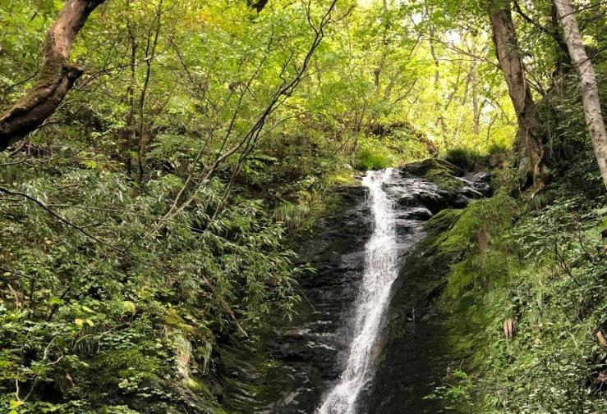
Water 水
Melting snow from the mountains carries clean & soft water.
Soft water enables brewing of soft sake
Notes:
.

Slide 11
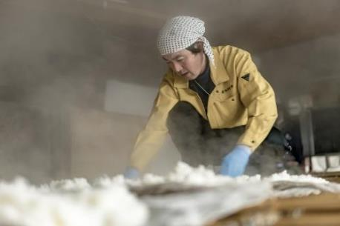
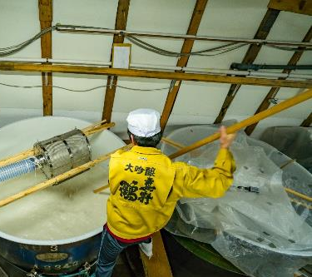
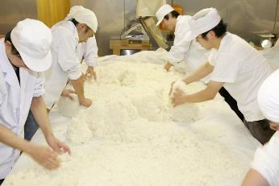
People 人
Our Motto
Brew master (Toji) Kenya Kudo cooling down steamed rice
Brewery worker preparing the fermentation mash
Brewery workers (Kurabito) making Koji

Slide 12
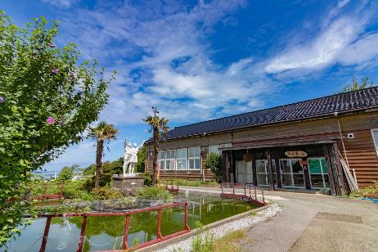
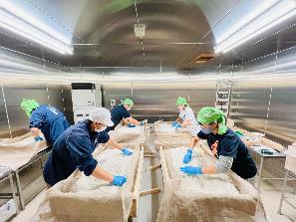
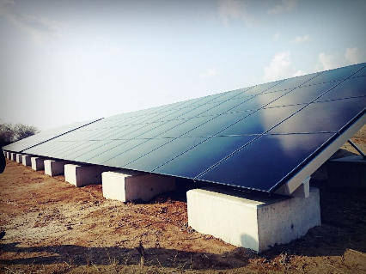
Sustainable Energy
Energy Circulation
Gakkogura, Obata Shuzo’s 2nd brewery
Renovated an abandoned elementary school
Joint studies with Tokyo University and community with other stakeholders
Renewable energy with solar panels

Slide 13
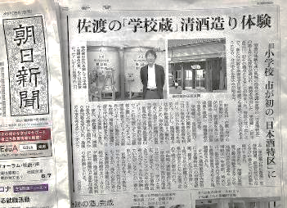
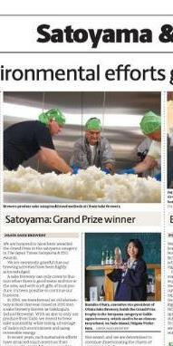
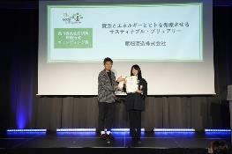
2020
Government of JAPAN
Cabinet office
Sake Special Zone
Certification No.1
2022
the Ministry of the Environment
The Environmental Regional Branding Award
2020
「The Japan Times」
SATOYAMA Award

Slide 14
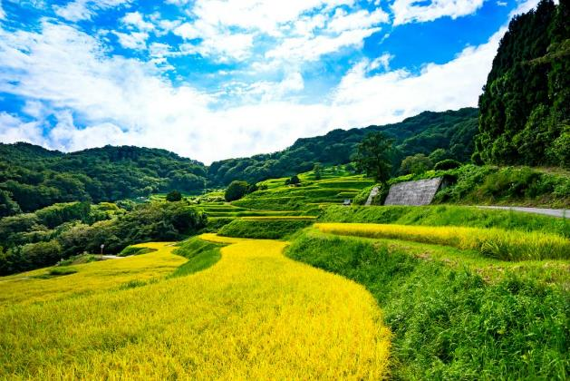
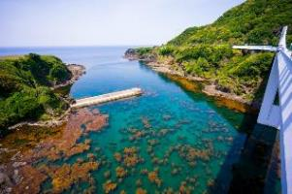
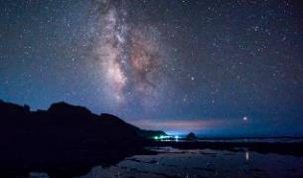
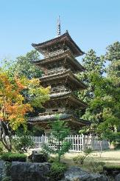
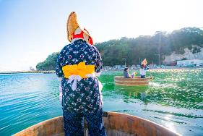
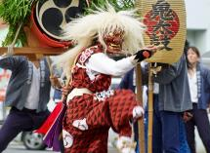
Microcosm of Japan
An Island of Diversity in Nature, Culture
and History

Slide 15
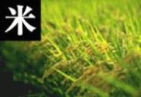
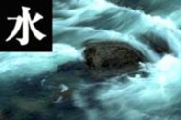
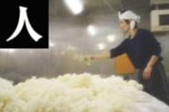
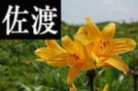
Our Motto
Brewing Sake by harnessing
Rice, Water, Brewers and the teroire of Sado Island

Slide 16
Manotsuru in the USA
MAHO
Crane
Honjozo
Crane
Junmai
Demon
Slayer
Bulzai
Rumiko
Daiginjo
Countless
Visions
Pure
Bloom
Honjozo
Junmai
Special
Honjozo
Ginjo
Daiginjo
Daiginjo
Junmai
Nigori
Junmai
Ginjo
65%
SMV +7
65%
SMV +5~+6
60%
SMV+15
55%
SMV+5
50%
SMV±０
35%
SMV±０
60%
SMV−9
60%
SMV−20
Sharp
Mild
Super Dry
Refreshing
Rich & Elegant
Light & sour
Very
Sweet
Regular type
Dry type
Fruity type
Sweet type

Slide 17
Regular Type (Dry & Clearn)
Basic sake with dry & clean style. Good with Japanese food.
Can be served hot as well,

Slide 18
Regular Type (Dry & Mild)
Basic Junmai with dry & mild style. Good with Japanese umami food. Can be served warmed as well.

Slide 19
Super Dry Type
Super Dry Sake with SMV +15.
Good with sushi, oyster and even steak .

Slide 20
How to discrive the dryness ?
Demon Slayer
Measure for the dryness of Sake: SMV = Sake Meter Value
＋15
Drier
＋10
+5
+2
Neutral
±0
-2
-5
Nihonshu-do +15
SMV+15
(Sake Mater Valur )
-10
Sweeter
-15

Slide 21
Dry & Fruity Type
SMV:+5~+7
Dry ginjo with fresh yellow apple and mineral.
Acts as a lemon poured over the food.

Slide 22
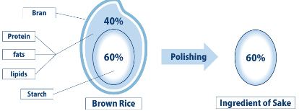
Polishing ratio
Bulzai
720ml
300ml
Polishing Ratio
left-over % of polished rice grain
Polishing ratio 55%

Slide 23
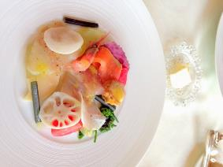
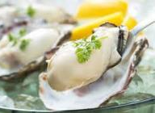
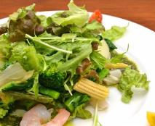
Dry & Flowery Type
真野鶴Rumiko大吟醸
Rumiko Daiginjo
Daiginjo
RPR:50%
Rice: Gohyakumangoku
SMV:+5
Light, gentle aroma of white flower and dry smooth aftertaste. Good with appetizers and salad.
Daiginjo with dry smooth & flowery aroma.
Good with appetizers and salad
.

Slide 24
A pairing that goes better with sake than wine
【UMAMI food】 Dashi and other tasting dishes which you will feel UMAMI
【NIGAMI Vegitables】 Vegetables whichcontain
NIGAMI (bitterness) such as Asparagus,
green bell pepper and etc.
【Seaweed】 Iodine scent from seaweed, oyster and
shellfish does not go well with wine.
【Cheese】 Wine wash the taste of cheese, but Sake enhances the flavor of the cheese in your mouth.
【Egg】 When you combine wine and egg / fish roe, you feel unpleasant smells
【Beer & Caviar】Fatty acid in beer / caviar is simmilar with capron acid in fatty acid of Daiginjo.
【Hot spice】 Sake can take on the strong flavors of spice such as wasabi, ginger, and cumin

Slide 25
Rich & Elegant Type
- National New Sake Award
GOLD medal 13 times since 2001
- International Wine Challenge
(IWC) GOLD 2007, 2015

Slide 26
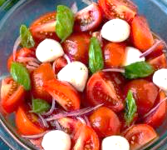
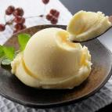
Light & Sweet honey

Slide 27
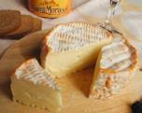
Light Sweet Nigori

Slide 28
Hight Aroma
Dry
Sweet
Calm

Slide 29
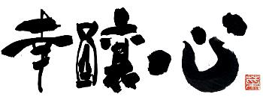
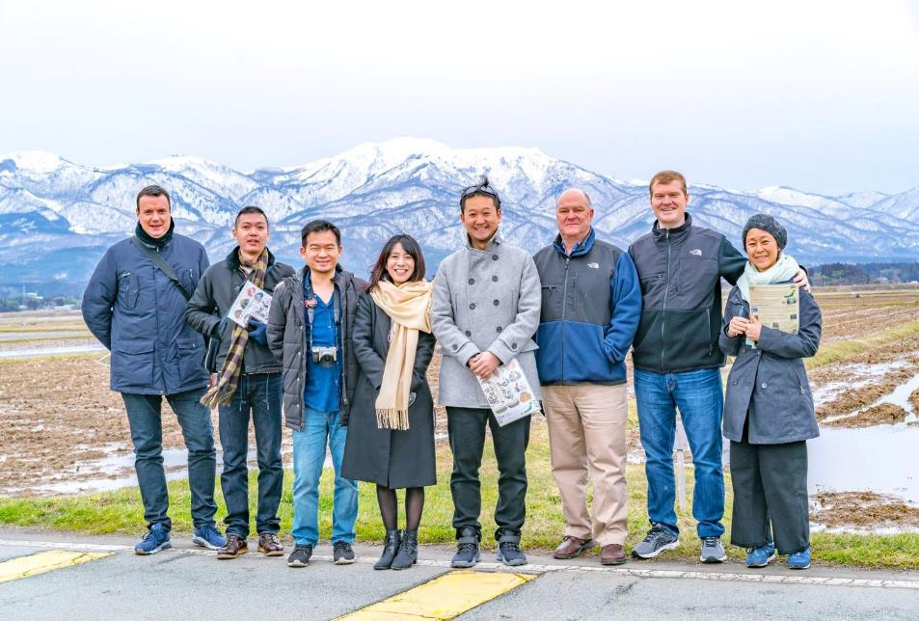
Brew Happiness by Brewing Sake

Slide 30
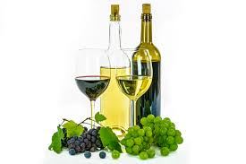
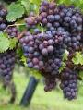
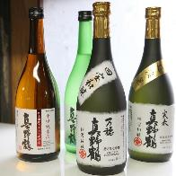
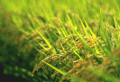
【Compare the Fermentation process of Wine and Sake】
Wine Yeast
1:Ingredients
WINE
Fermentation
Grapes
（Sugar=Glucose）
3
Single Fermentation
2
Koji Mold
Water
1:Ingredients
Saccharification
Starch→sugar
SAKE
Sake Yeast
=Kobo
Fermentation
Sake Rice
（Starch）
Sugar→Alcohol
3
Multiple Parallel Fermentation
MANOTSURU

