Slide 1
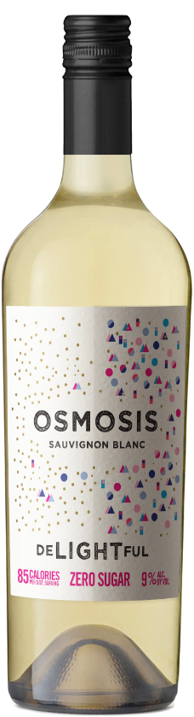
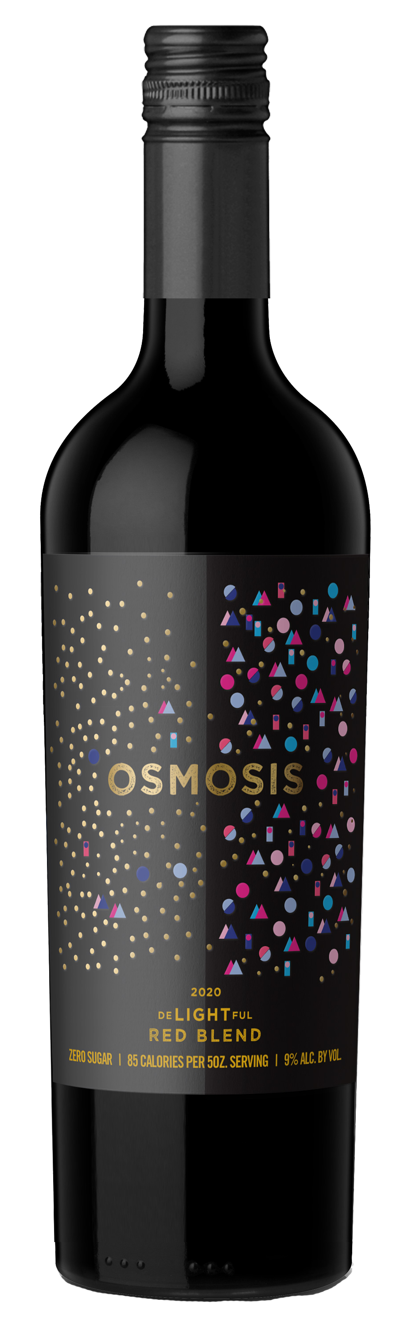
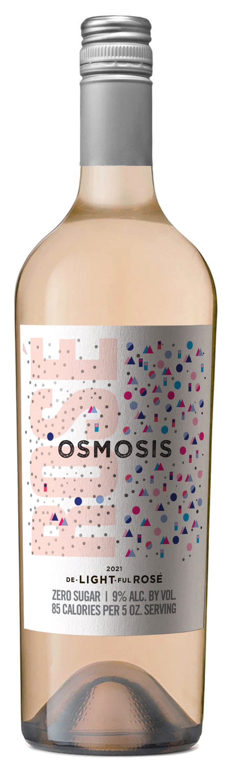

From Your Trusted Source!

Slide 2






In the Press:
As a growing number of people choose to drink ‘less and better’, the universe of low- and no-alcohol beverages is rapidly expanding and improving…Whatever your view, low- and no-alcohol wine seems here to stay
29% of drinkers are imbibing less to reduce their caloric intake, and a study by Nielsen found that 21- to 34-year-olds in the United States are 40 percent more likely to drink less than older generations."
There’s no need to sacrifice flavor or body when looking for a healthier pour…The “no-and-low” wellness trend is well under way in the wine world, with the market for low- and no-alcohol drinks expected to grow 32% .
One thing everyone seems to agree on: No-/lo-alcohol drinks are here to stay. A new generation is awakening to the idea that a good time doesn’t necessarily require a buzz.”
Beverage Dynamics Alcohol Trends for 2024
No- and low-ABV wine
“We’ve seen health, wellness, and balance take center stage over the past few years,” says Angela Slade, Vice President Communications at Opici Wines and Spirits. “Most distinctly over these past months alongside the growing awareness of Sober October and Dry January.”
Mindful drinking, along with health and wellness, is a trend that is here to stay.

Slide 3
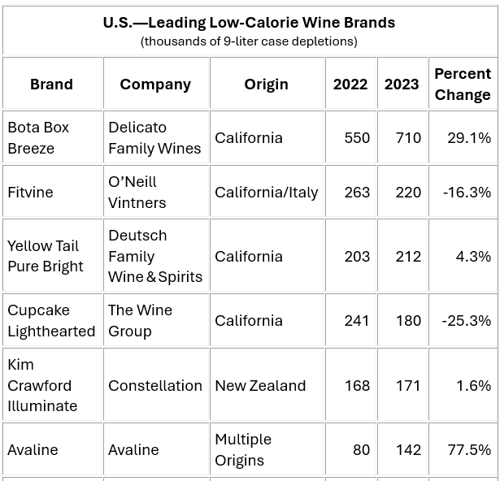
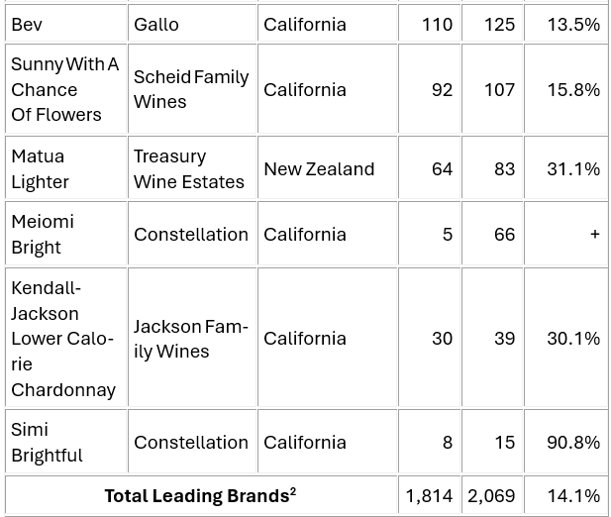
Wine's Low- And No-Alcohol Segment Gains Momentum With Younger Drinkers*
The Facts:
The “better-for-you” segment also registered another double-digit gain last year (2023), as younger American drinkers increasingly opt for health- and wellness-oriented brands.
Table Wine OFF Premise dollars decreased -1.3% to $19.5 billion (319MM Cases) in Nielsen/NIQ 2023, but the “better for you” sector rose +11.4% to $788.5 million (3 Million Cases!).
Who is Driving Trend? Predominately LDA 35-year-olds, and younger groups are increasingly exploring this category.
Established brands entering the category—Kim Crawford, Kendall-Jackson, Meiomi, Duckhorn, Simi and 19 Crimes…
*Source: Shanken IMPACT DATABANK © 2024

Slide 4
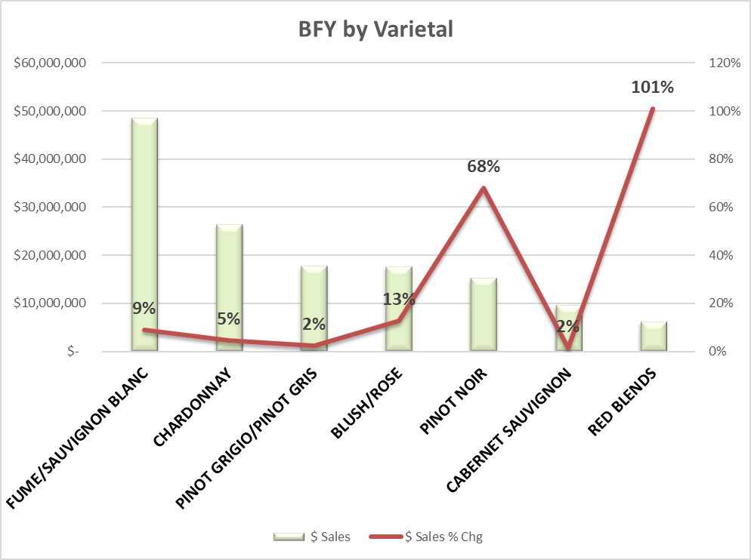
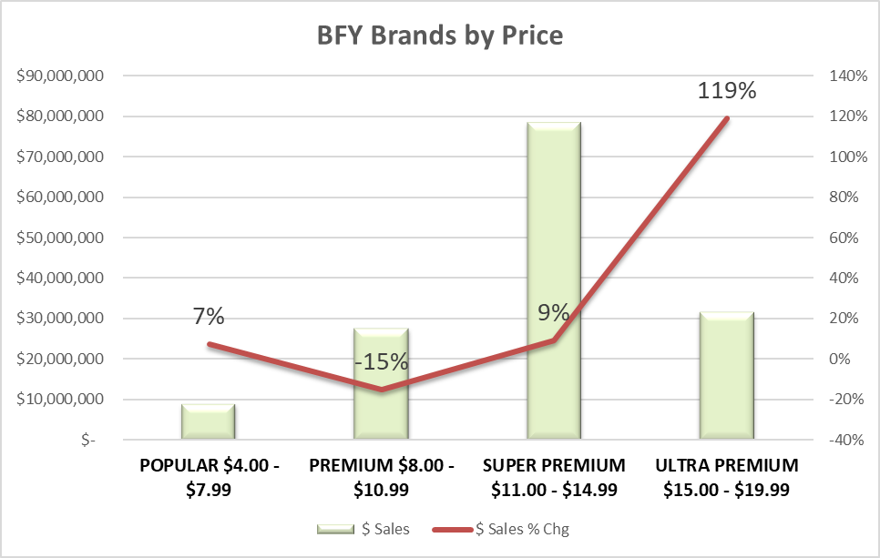
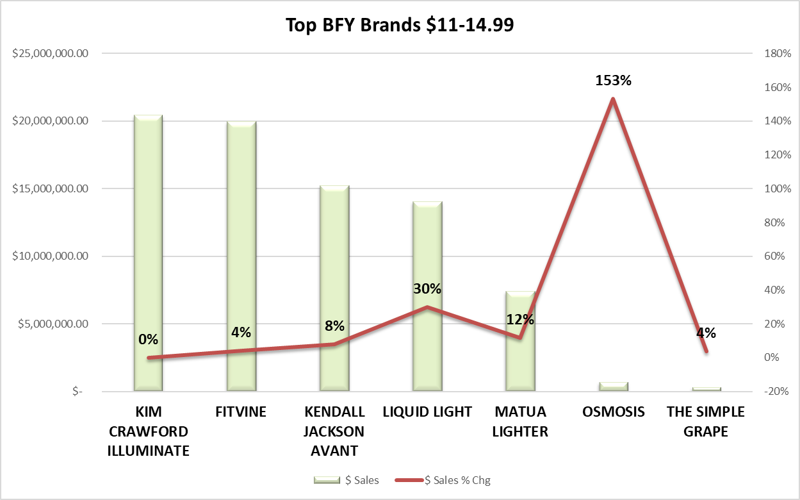
A Peek Inside the Category!!
Headlines:
BFY Top Varietals are SB but big growth coming from Rose and Red Blends.
Consumers will trade up for BFY with Super Prem being the biggest in $s. Growth in Super + Ultra prem.
In $11-14.99 Top BFY brands are coming from large commercial brands… Osmosis is from FAMILY OWNED, ESTATE FRUIT, SUSTAINABLY FARMED! Support Patricia Ortiz (Zolo, Tapiz, Wapisa).
Sourcing: IRI L52 Total MULO ending 6.30.24

Slide 5
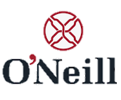


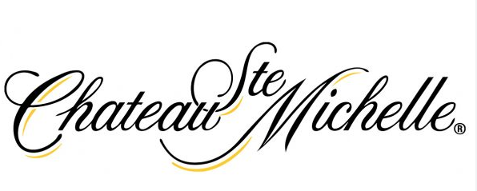


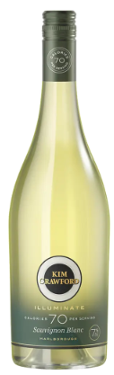
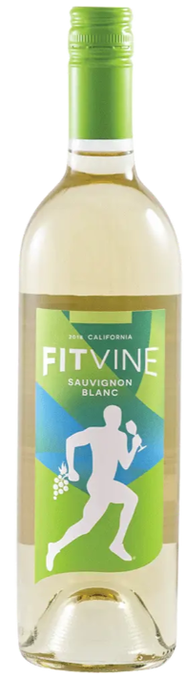
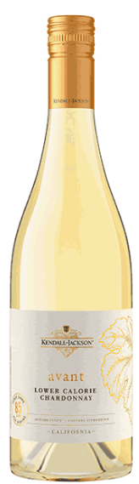
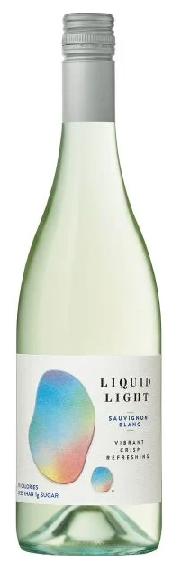
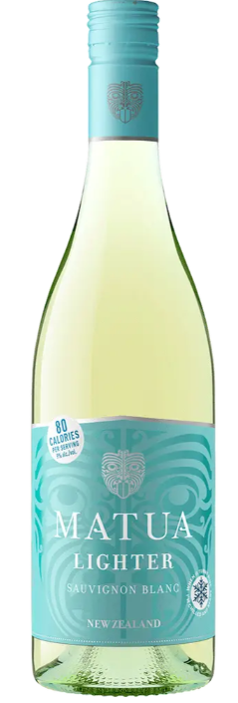
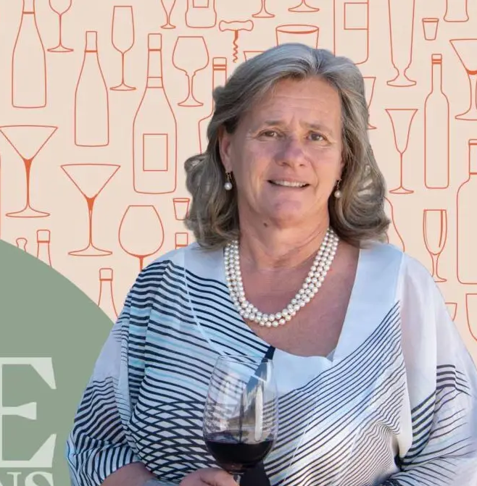
Competitive Set $11-14.99:
Sourced from Family-Owned Vineyards- Patricia Ortiz
Kim Crawford Illuminate 0%
FitVine 4%
Kendall- Jackson Avant 8%
Liquid Light 30%
Matua Lighter 12%
Osmosis +153%
Notes:
Constellation + Chateau St Michelle + TWE are owned by private equity.
Oneill purchased Fitvine
Jackson Family is family owned by the wife of Jess Jackson- only 1 SKU
Osmosis is sourced from Family vineyards!

Slide 6

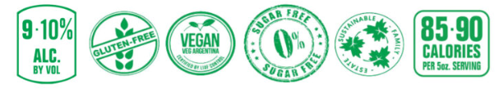


Why Osmosis?
Osmosis was born to meet the concerns of today’s consumer- to fit their health- conscious lifestyle!
Award Winning Family-Owned Vineyards by Patricia Ortiz (Zolo, Tapiz, Wapisa)
Estate Fruit allows us to control the harvest practices and sourcing. The consumer gets THE best tasting quality wine. Osmosis is hand harvested at 3 different stages then blended:
  Early Harvest = lower alcohol and bright acidity
  Middle Harvest = floral and fruit notes
  Later Harvest = concentrated, ripe, round flavors
Sustainability
  High altitude terroir allows for perfect arid conditions for no pesticide use.
  All water is recycled, reused.
  All Osmosis bottles are in eco-friendly, lightweight glass- 390 grams
  Cyclical Agriculture- Recycling program in the vineyard provides high quality bio compost made from the grape's skins and stalks. The compost is then used as fertilizer back in the vineyards.
  Osmosis’ vineyards are certified by GLOBAL G.A.P. Provide standards and protection of farming practices, water use, recycling, energy efficiency, pest management, sustainably sourced raw materials- assessing environmental impact.
Taste! Osmosis has been recommended by the Somm community – try it and become a believer!
390 grams

Slide 7
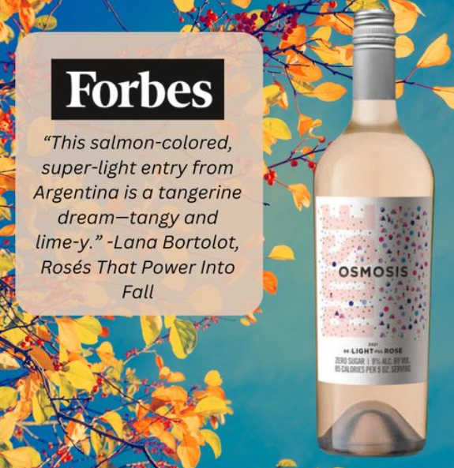
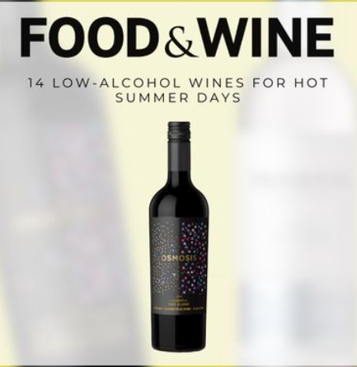
How to SELL Osmosis?
Taste first -Speak Second!- Have the buyer taste before mentioning its lower in calories and alcohol, zero sugar, Vegan, etc. This removes any preconceived notions that better for you = bad taste
Off Prem- These wines do well in the varietal set or in a cold box, be sure to utilize the necker, shelf talker and/ or case cards.
On Prem- wine list, suggest the “85 calories per serving and/ or zero sugar” is listed. This shopper is LOOKING for direction.
Osmosis IS Social!!
  Social media campaign includes Instagram, Facebook, and website!
  “How we Made the Best Better-for-You Wine” at: https://vinodelsol.com/thewineries/osmosis
Buyer Pushback? Don’t Worry!
“I don’t have customers asking for healthier wine.”
  Answer: Its coming! According to Forbes, consumer demand for “Better for You” wine is skyrocketing, and syndicated depletion data shows that these wines are a bright spot in a down market. Don’t miss out by not offing an alternative to your consumers. Remember when people thought Lite Beer would be a fad?
“Something is missing in this wine.” Some may come to this conclusion not on the wine’s merits, but because they have a preconceived notion given it is lower in calories, sugar and alc.
  Answer: Consumers love this wine. After many trials, Osmosis is the best tasting, BFY wine from family vineyards, estate fruit that is sustainably farmed. Osmosis has been featured in FORBES and FOOD & WINE and recognized by the SOMM community (check out multiple M.S. reviews on our website)!

Slide 8
Appendix

Slide 9







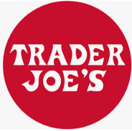




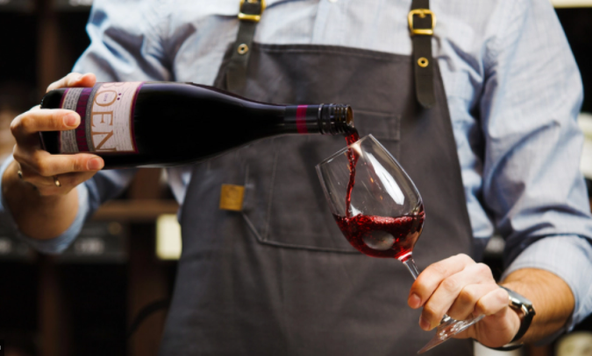

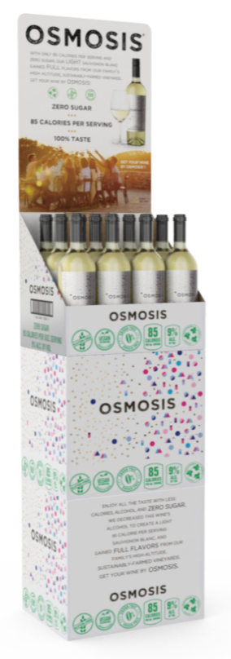
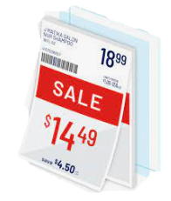
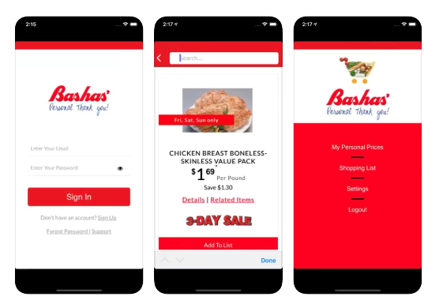

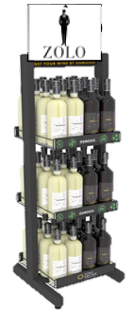
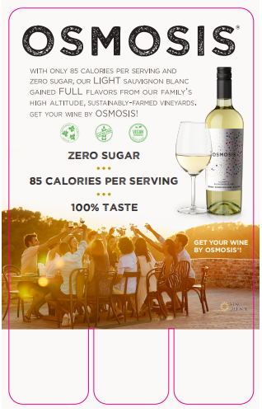
REASONS TO BELIEVE
Osmosis growing 153%, growth outpacing competition in $11-14.99**
“One thing everyone seems to agree on: No-/lo-alcohol drinks are here to stay.”*
“A new generation is awakening to the idea that a good time doesn’t necessarily require a buzz.”
-*Beverage Dynamics Alcohol Trends for 2024
Great Tasting Varietals targeted in HOT varietal categories: Sauv Blanc, Red Blend and Rose
Wine Trade Endorsements from Somm Community:
Chains Taking Notice:
OSMOSIS was born to meet the concerns of today’s consumer and to fit with their health-conscious lifestyle.
85 Calories
Zero Sugar,
Gluten Free,
Vegan Certified,
Family-Owned Vineyards,
Estate Fruit,
Sustainably Farmed
Attributes listed on back label-
easy for shoppers to identify
INVESTMENT/ SUPPORT
Social
Press
Demos
TPR/ Print/ Digital Coupon Support
QR Code Tech
POS/ Display
390 grams
SRP $14.99
**IRI L52 Wks 6-30-24
Notes:
Osmosis Reviews
Eric Hemer, MW/MS tasted the Osmosis Red and Rosé: His Notes Below
De-LIGHT-ful ROSÉ 2022 – Zero sugar, 9% ABV, 85 calories
“Medium watermelon pink color; clean and fresh on nose, notes of ripe summer fruits, peach, raspberry, watermelon, light, herbaceous note. Dry, medium-bodied, similar fruit profile on palate, tart, tangy, crisp acidity, balanced alcohol, a touch of chalky minerality, long, clean finish. Very well-made and satisfying. I don’t miss the extra 3-4% alcohol.”
De-LIGHT-ful RED BLEND 2021 – Zero sugar, 10% ABV, 90 calories
“Deep purple, opaque color; pronounced dark fruit on nose, black plum, black cherry, hint of cassis, touch of mocha, new oak indicator; on the palate, medium-plus body, the fruits turn a bit tart and manifests more as red than black fruit; raspberry, cherry, red plum flavors, hint of loamy/chalky earth. Medium tannin and acidity, balanced alcohol, long, clean finish. Again, very good, satisfying, don’t miss the 3-5% ABV.”

Slide 10
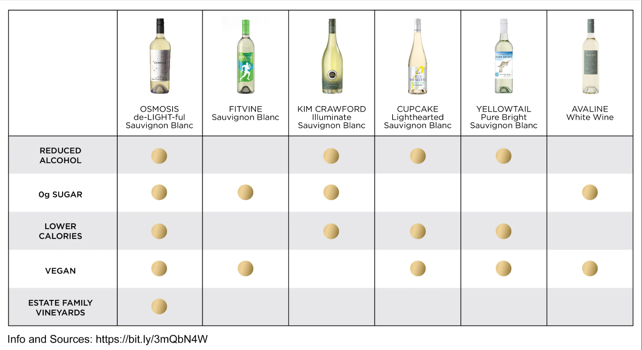

Slide 11
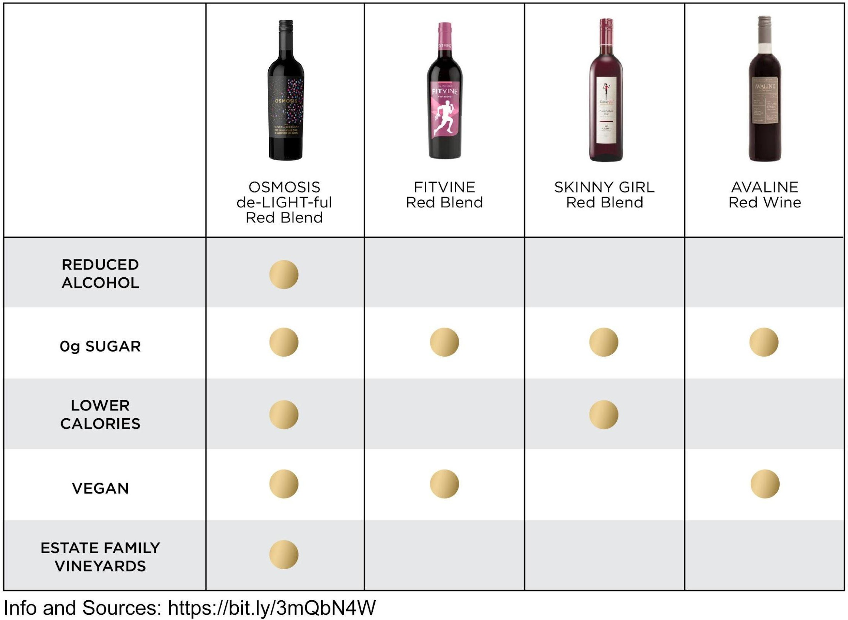

Slide 12
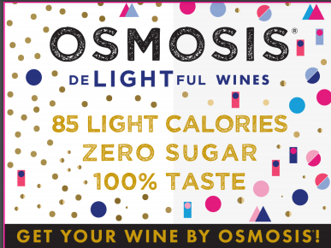
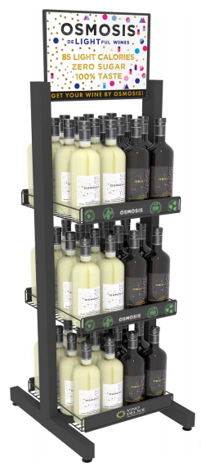
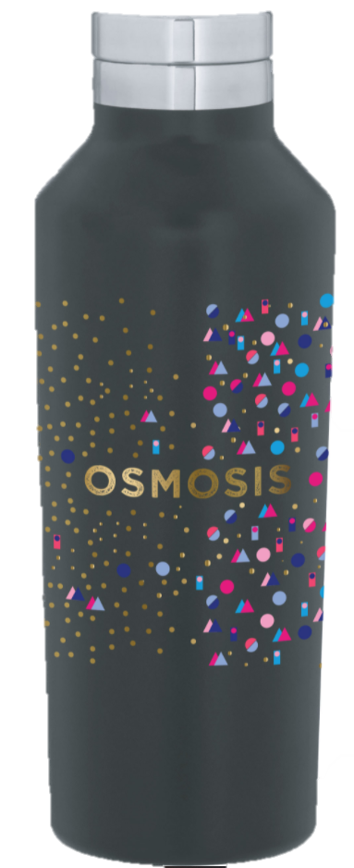
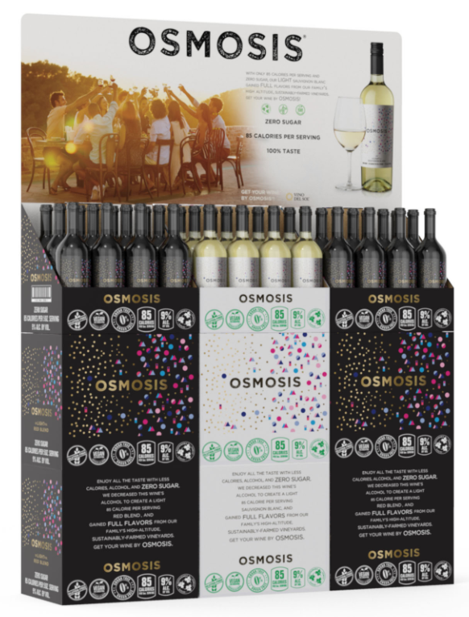
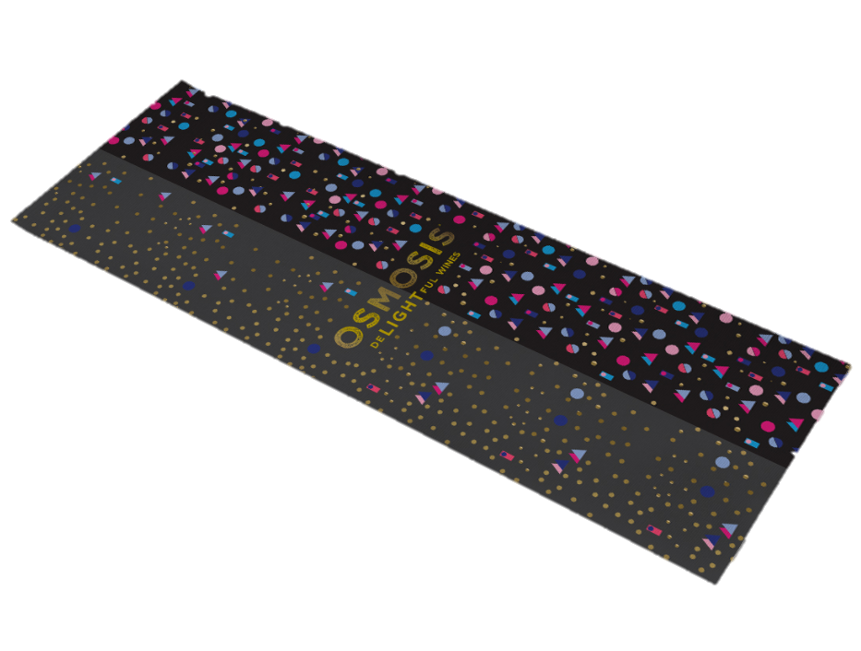
Racks
Case cards
Shelf talkers
Water bottles
Yoga Mat
Notes:
Tramonte order placed: 8/12
2 packs of single wide case cards
2 triple wide case cards
1 pack of sell sheets
2 packs of shelf talkers
10 XL shirts
4 speakers
5 water bottles

Slide 13

